Slide 1
Hibernate Application Development & CRUD Operations

Slide 2
Objectives
Data Management
Implement CRUD (Create, Read, Update, Delete) operations to manage data effectively.
Utilize Hibernate to map Java objects to database tables, simplifying data persistence and retrieval.
User Interface Development
Design and develop a user-friendly interface using JavaFX, enabling seamless interaction with the application.
Implement features such as form input validation, error handling, and feedback mechanisms to enhance user experience.

Slide 3
Student Management System
Build Simple Student Management System
Step 1. Setup JavaFX in Eclipse
Step 2. Setup Scene Builder
Step 3. Build CRUD Application with Repository Pattern
Step 4. Design GUI Application with JavaFX

Slide 4
Setup JavaFX in Eclipse IDE

Slide 5
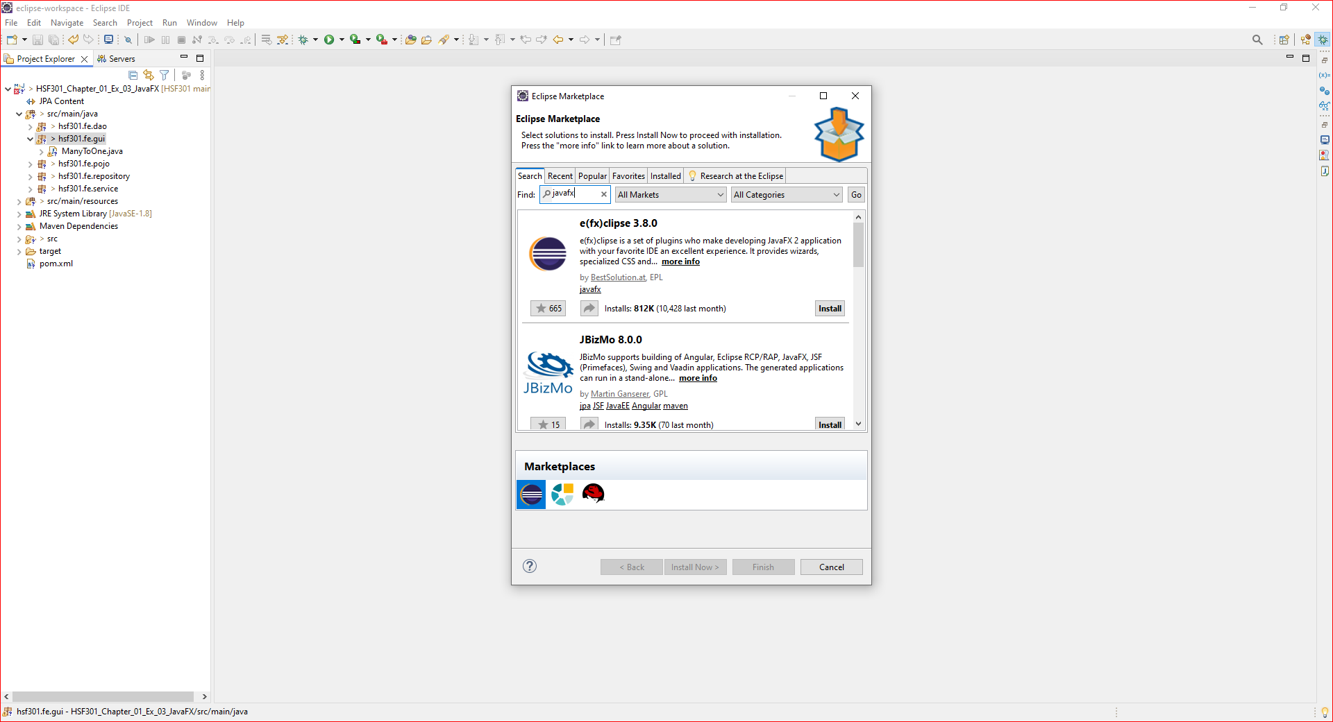
1. Open Eclipse, Help | Eclipse Market | e(fx)clipse

Slide 6
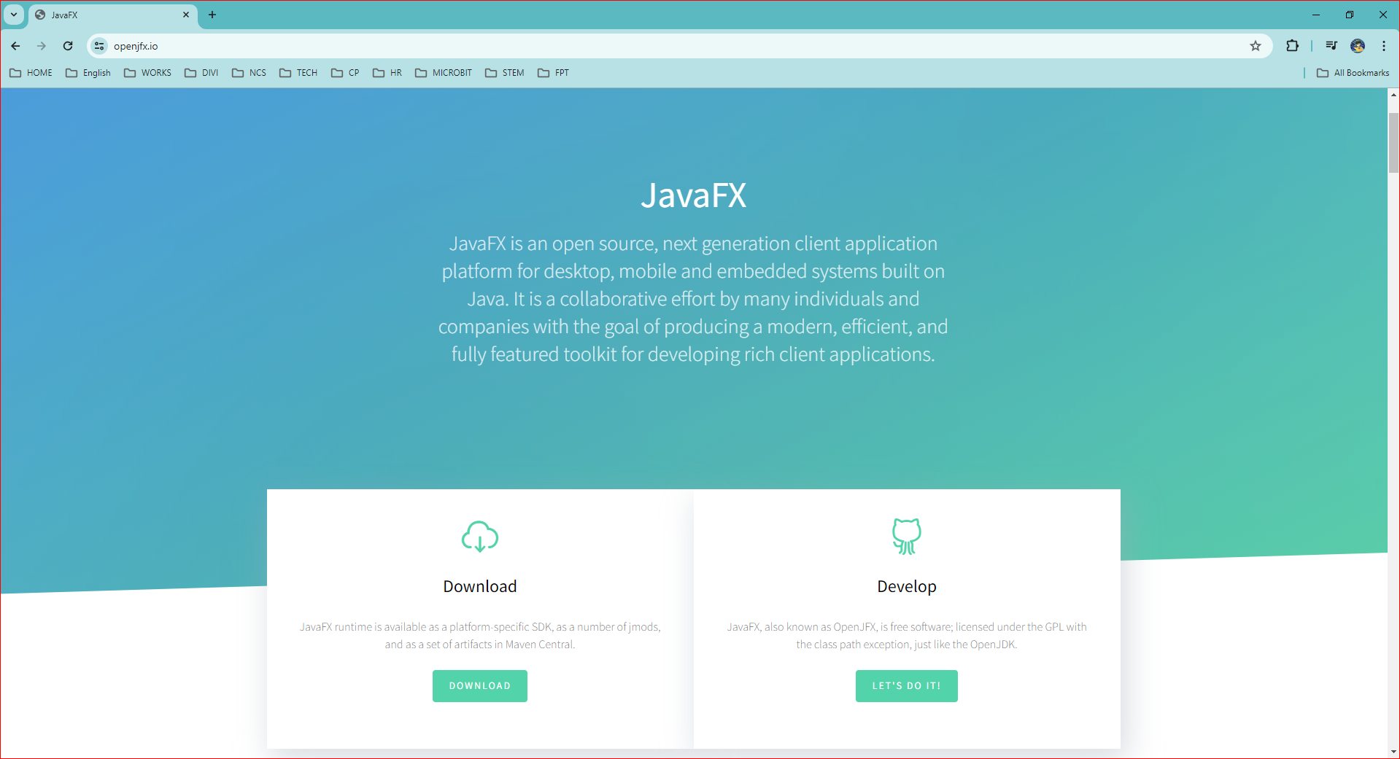
2. Open openfx.io page, download JavaFX

Slide 7
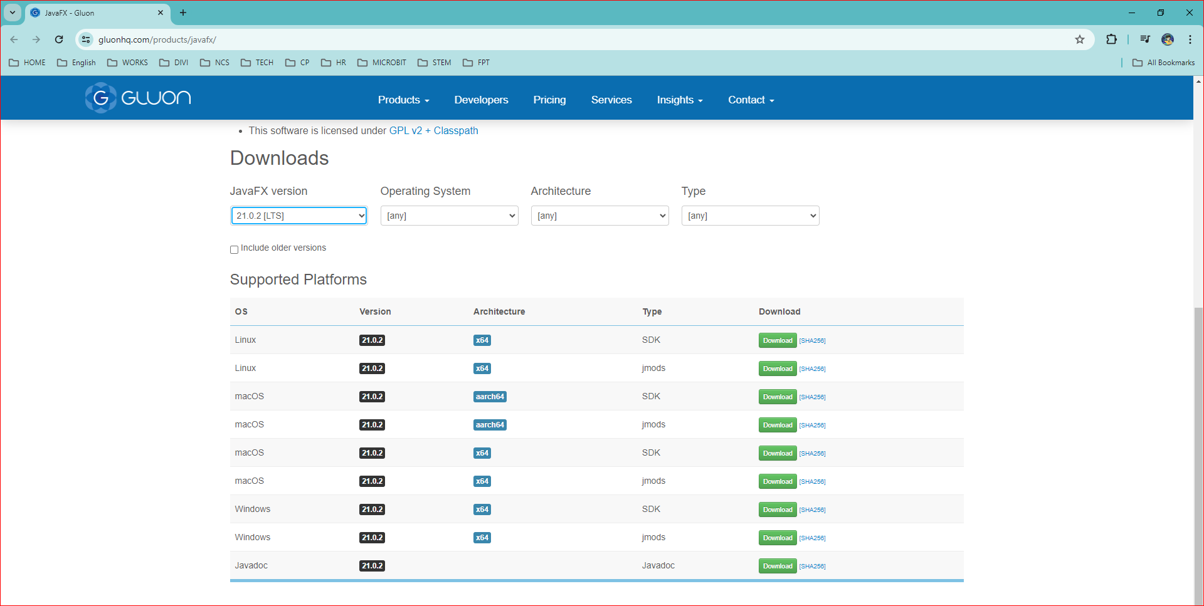
3. Download JavaFX

Slide 8
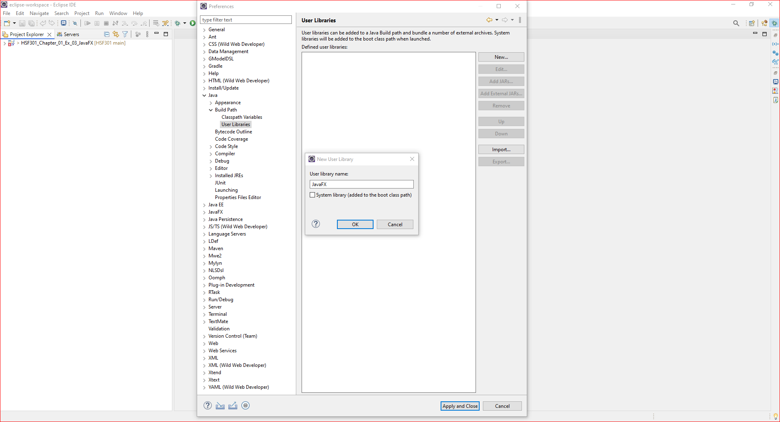
4. Open Eclipse, Window | Preferences | Java | Build Path | User Library

Slide 9
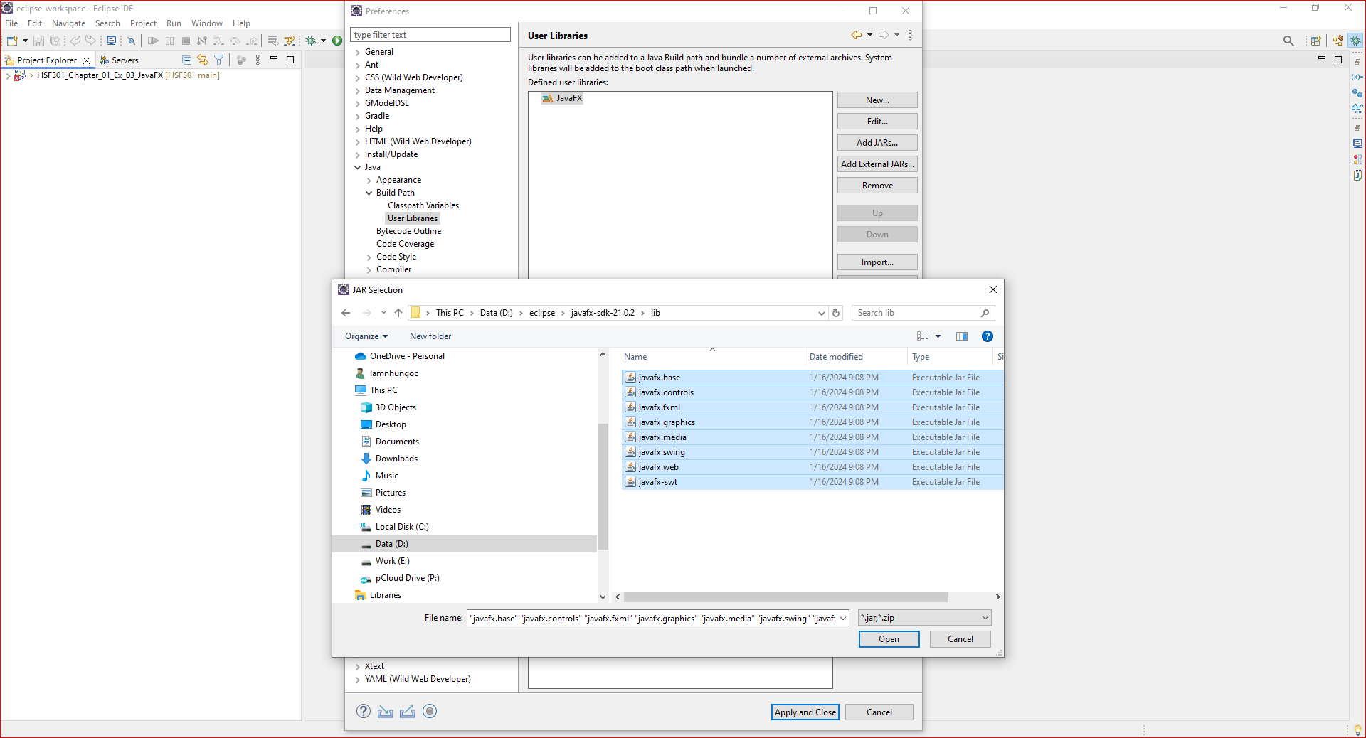
5. Extract JavaFX SDK, Add External JARs | Browser to JavaFX SDK lib

Slide 10
Setup Scene Builder

Slide 11
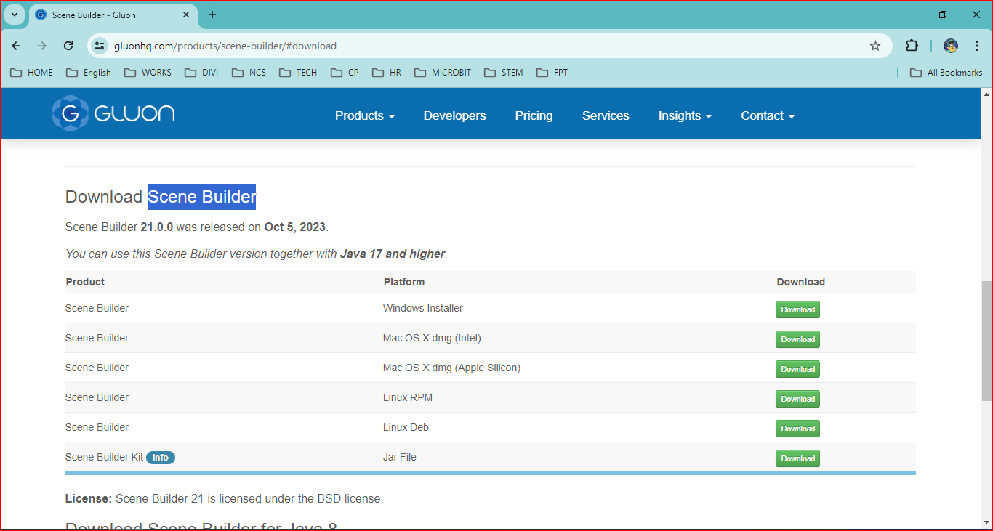
1. Open Eclipse, File | New | Maven Project

Slide 12
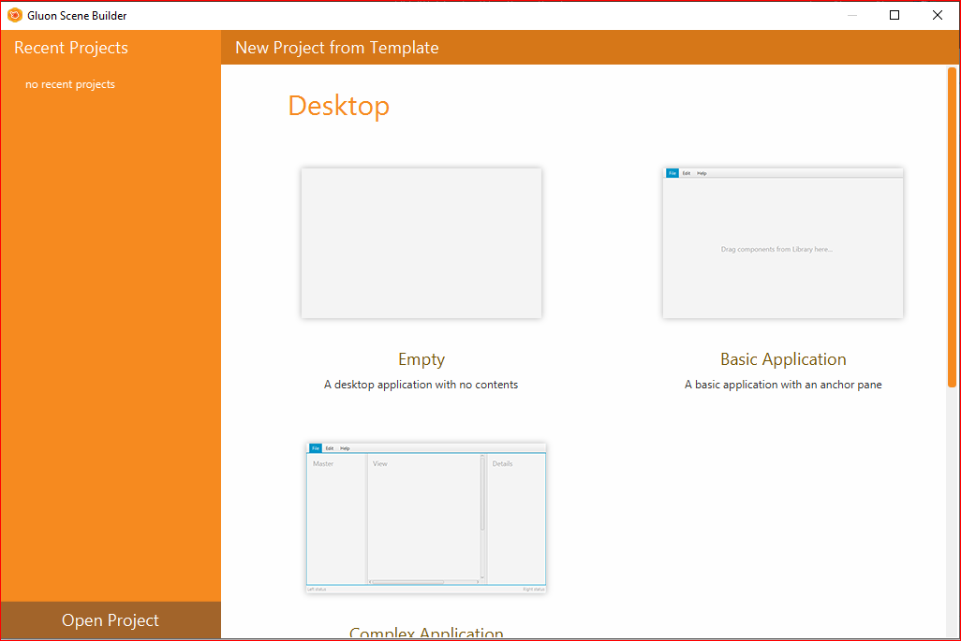
2. Open Gluon Scene Builder

Slide 13
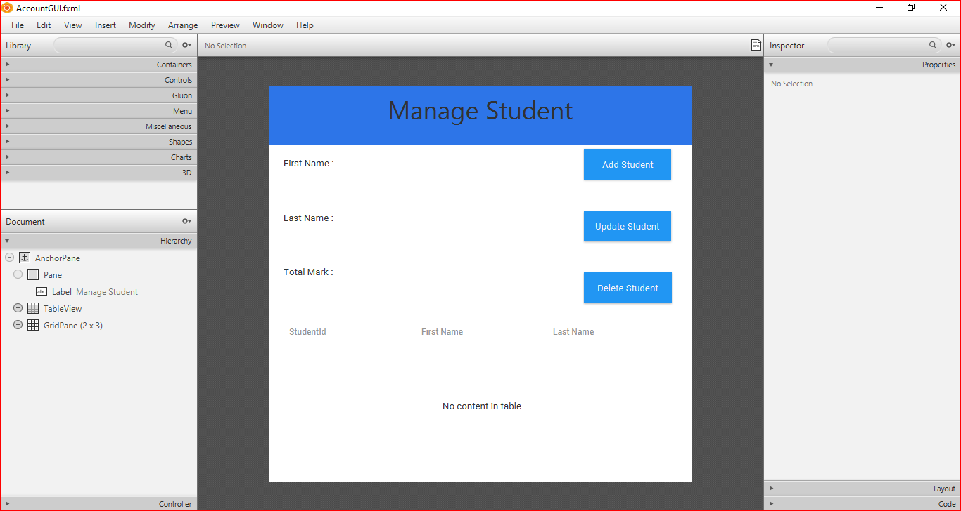
3. Open JavaFX File

Slide 14
Build CRUD Application with Repository Pattern

Slide 15
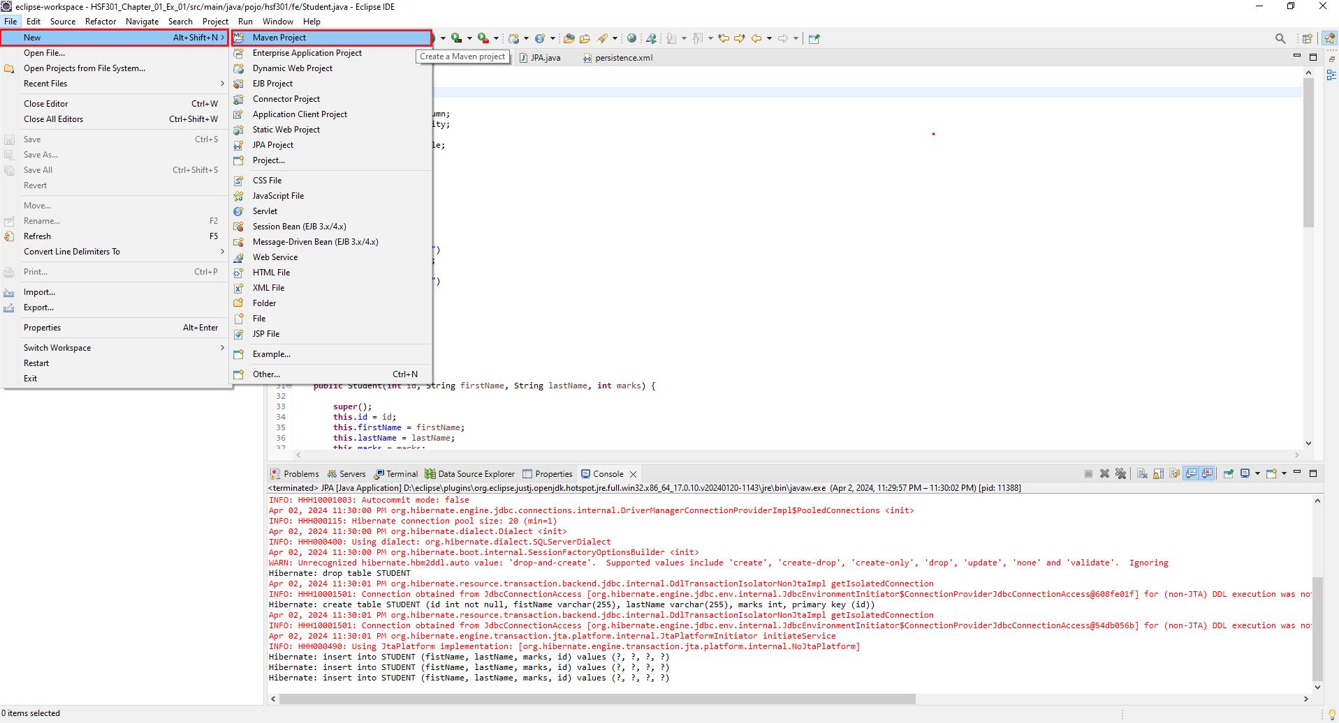
1. Open Eclipse, File | New | Maven Project

Slide 16
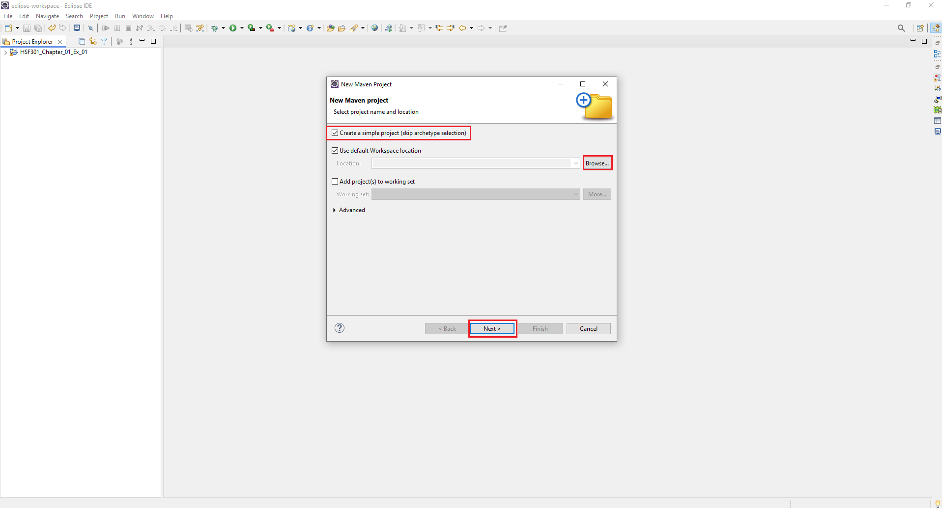
2. Check Create a simple project -> Browse Project -> Next

Slide 17
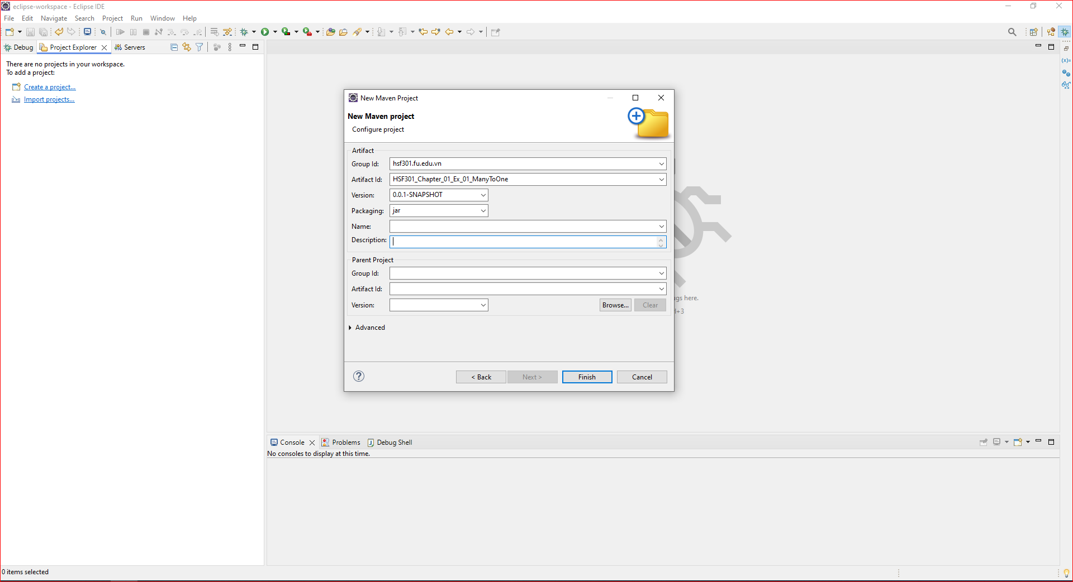
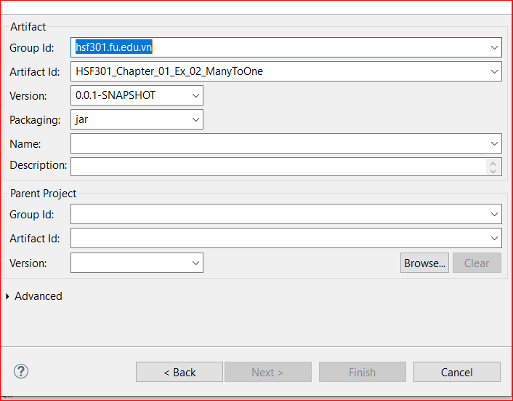
3. Fill the information Project -> Click Finish

Slide 18
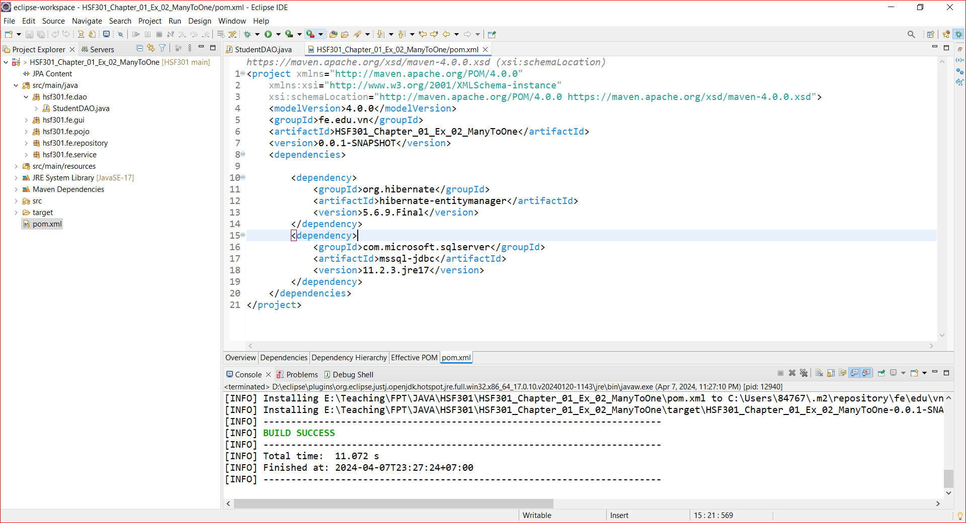
4. Structure of Maven Project

Slide 19
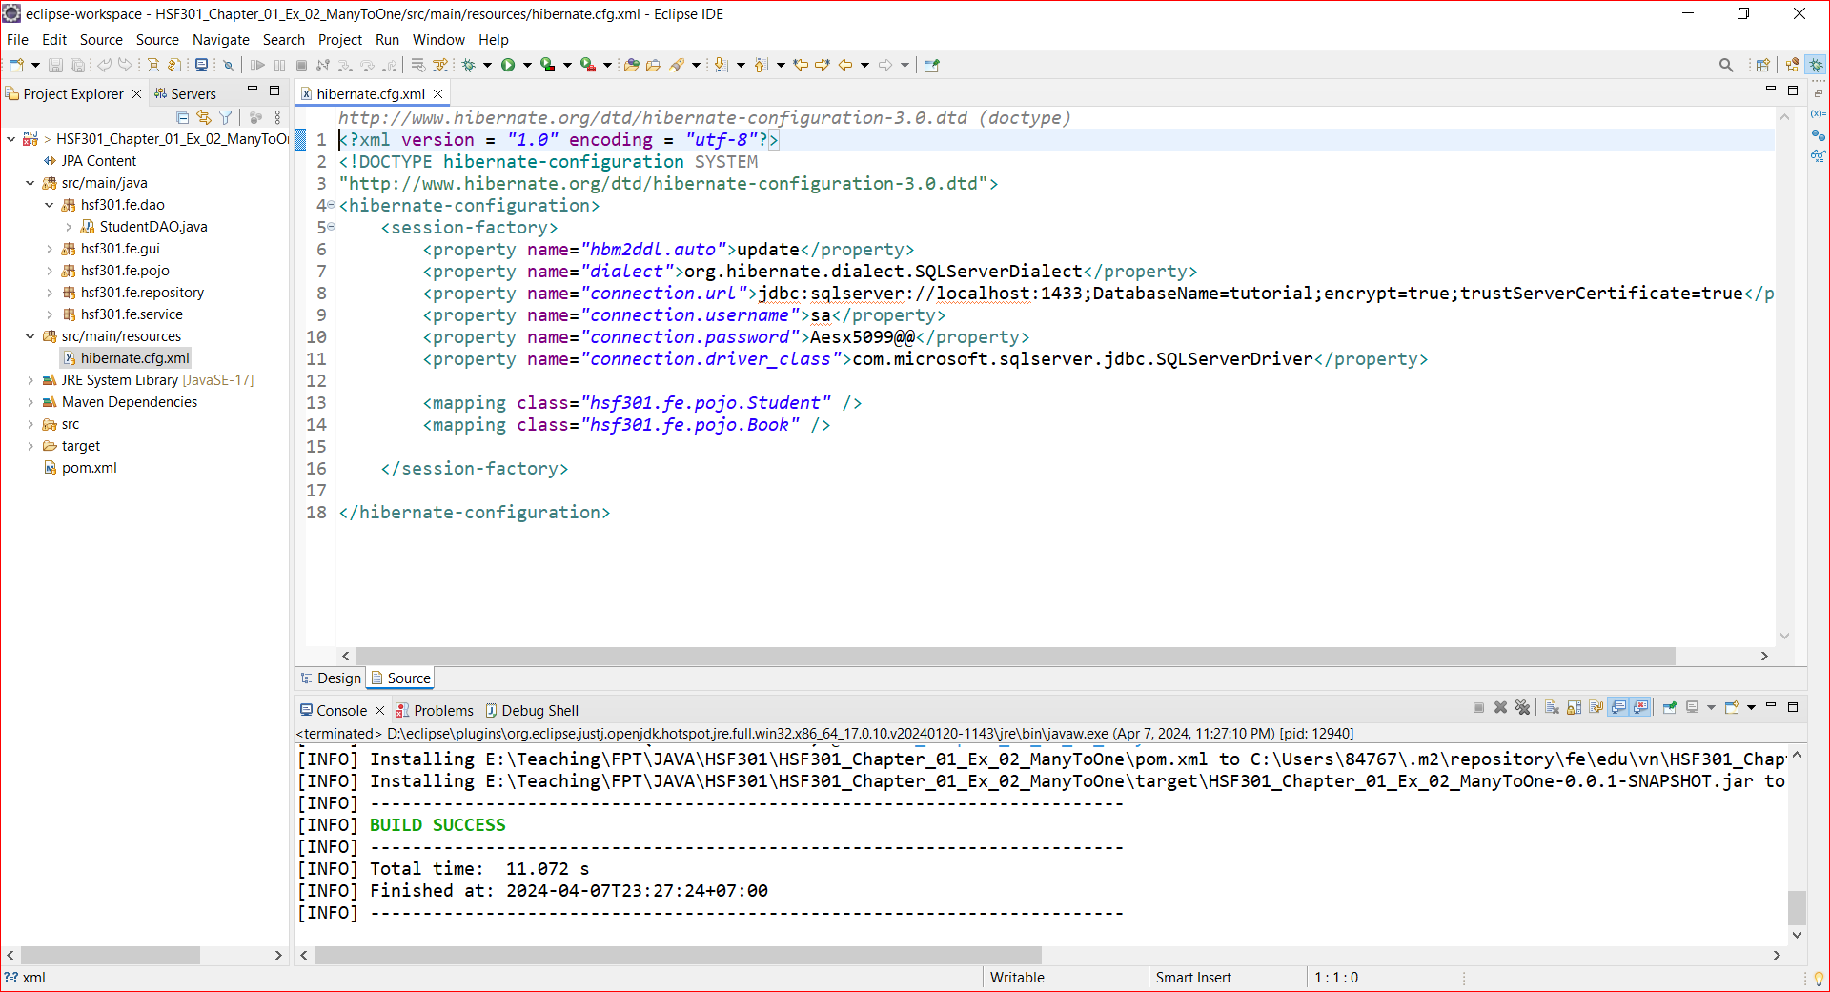
5. Create hibernate.cfg.xml

Slide 20
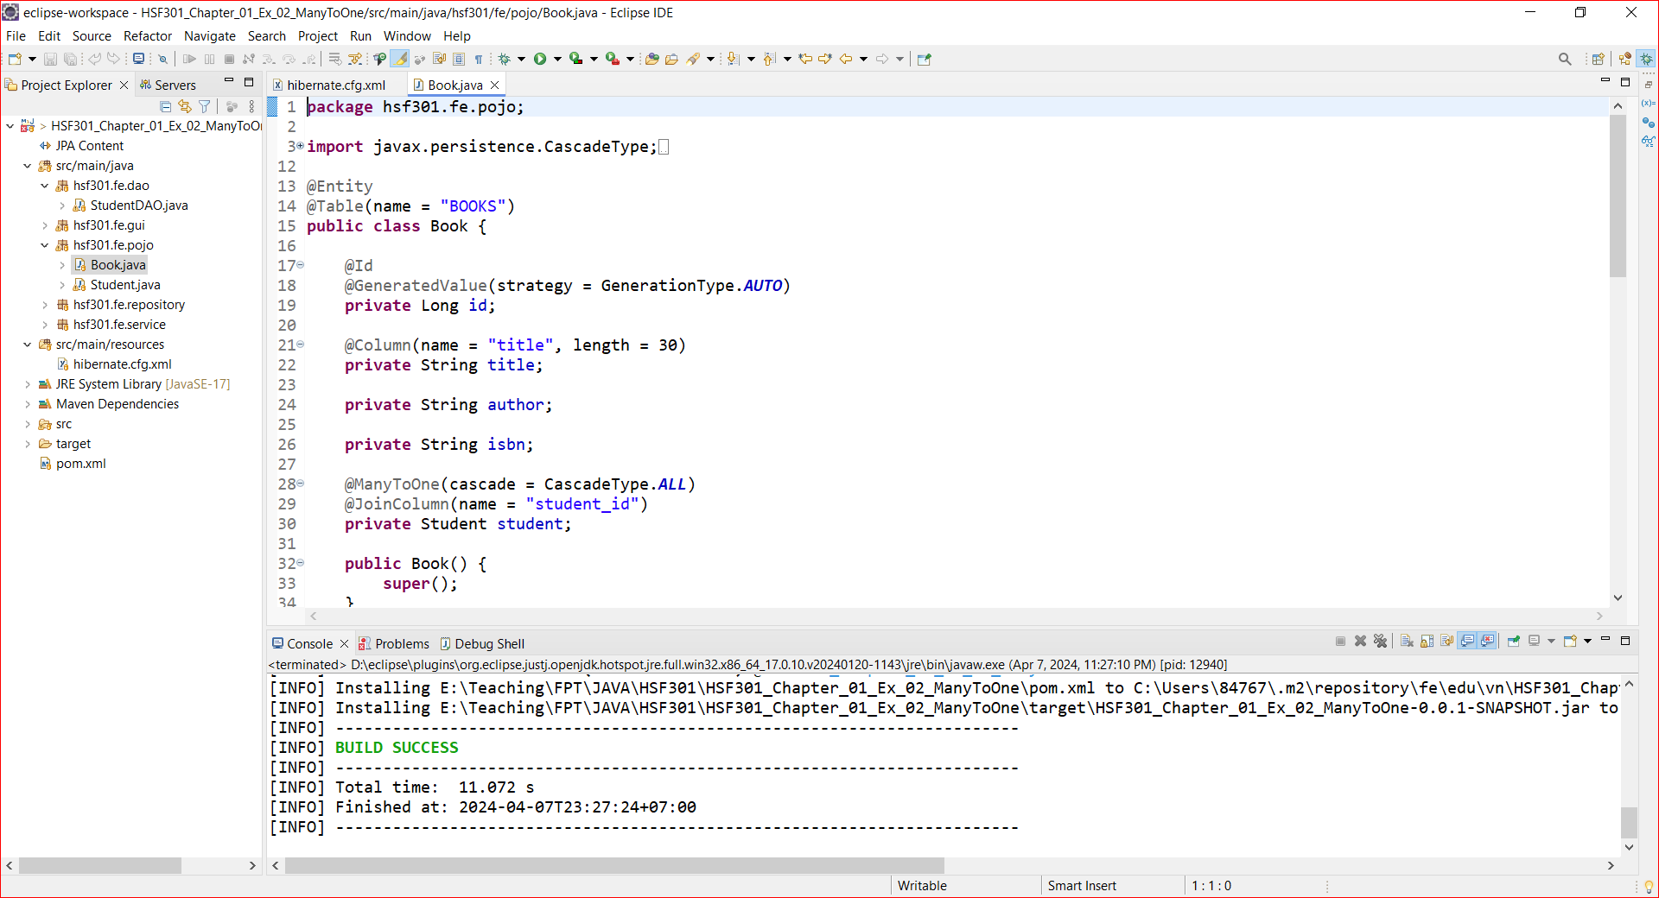
6. Create Books in Pojo

Slide 21
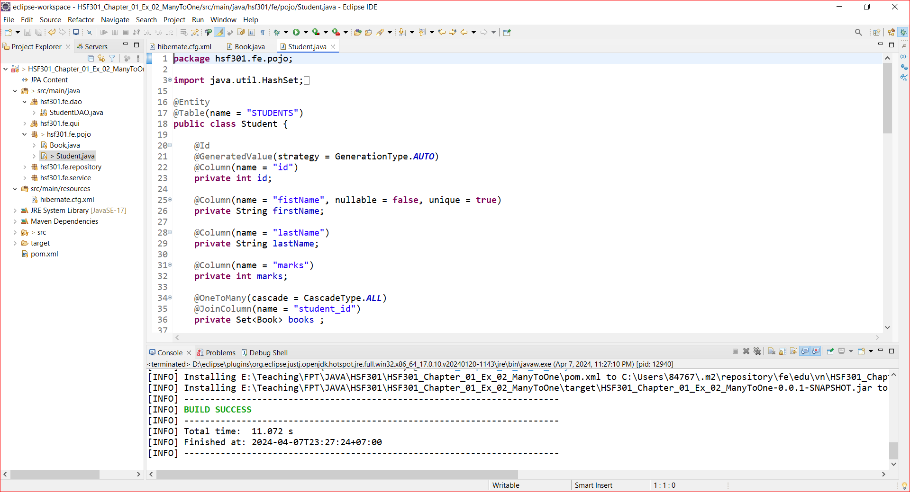
7. Create Students in Pojo

Slide 22
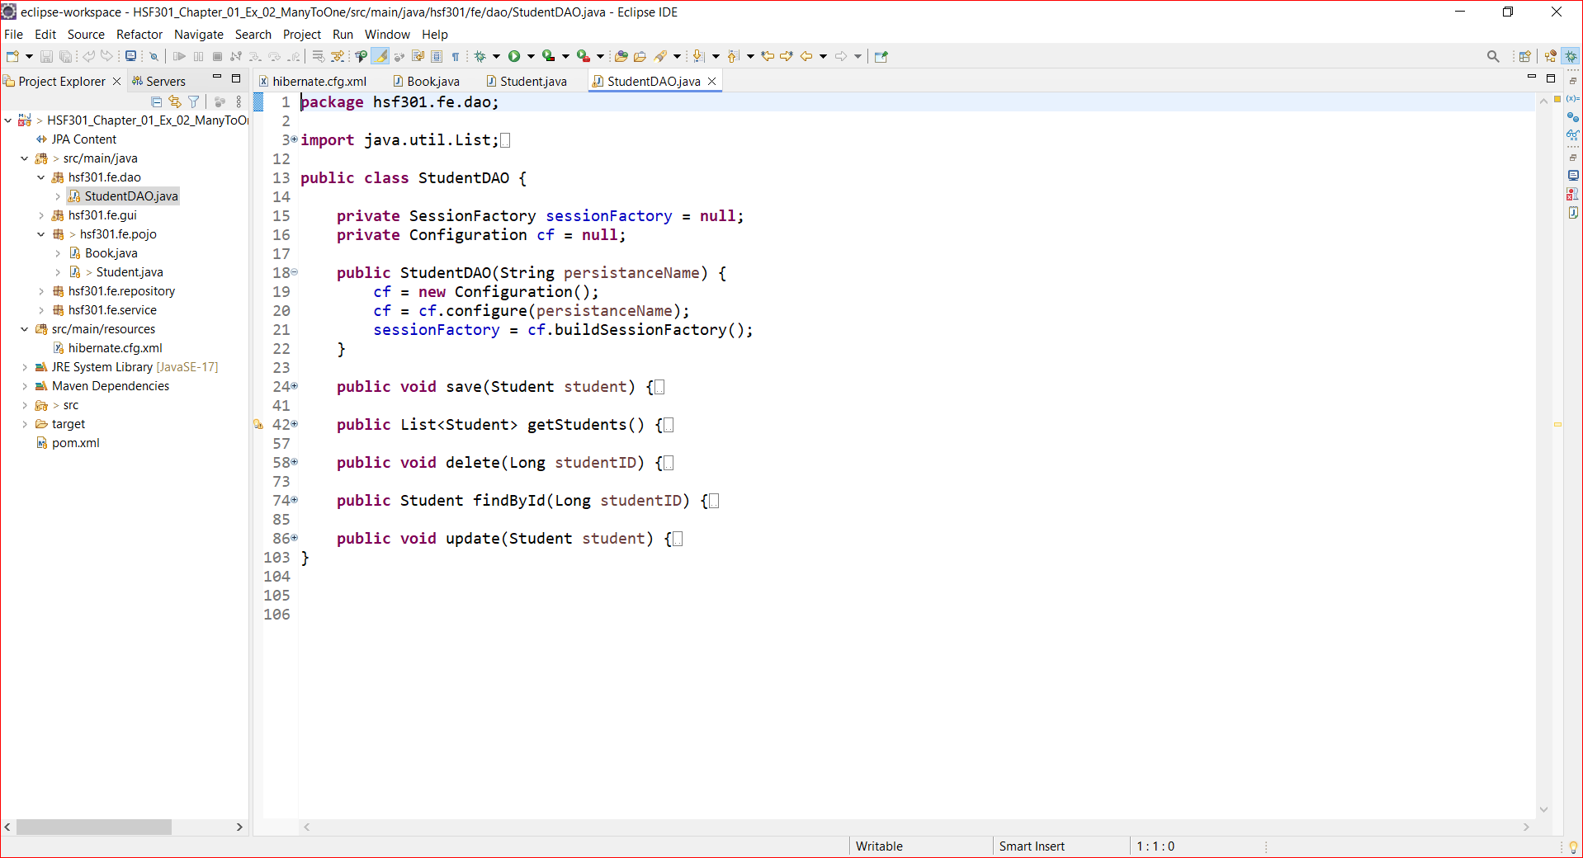
8. Create StudentDAO

Slide 23
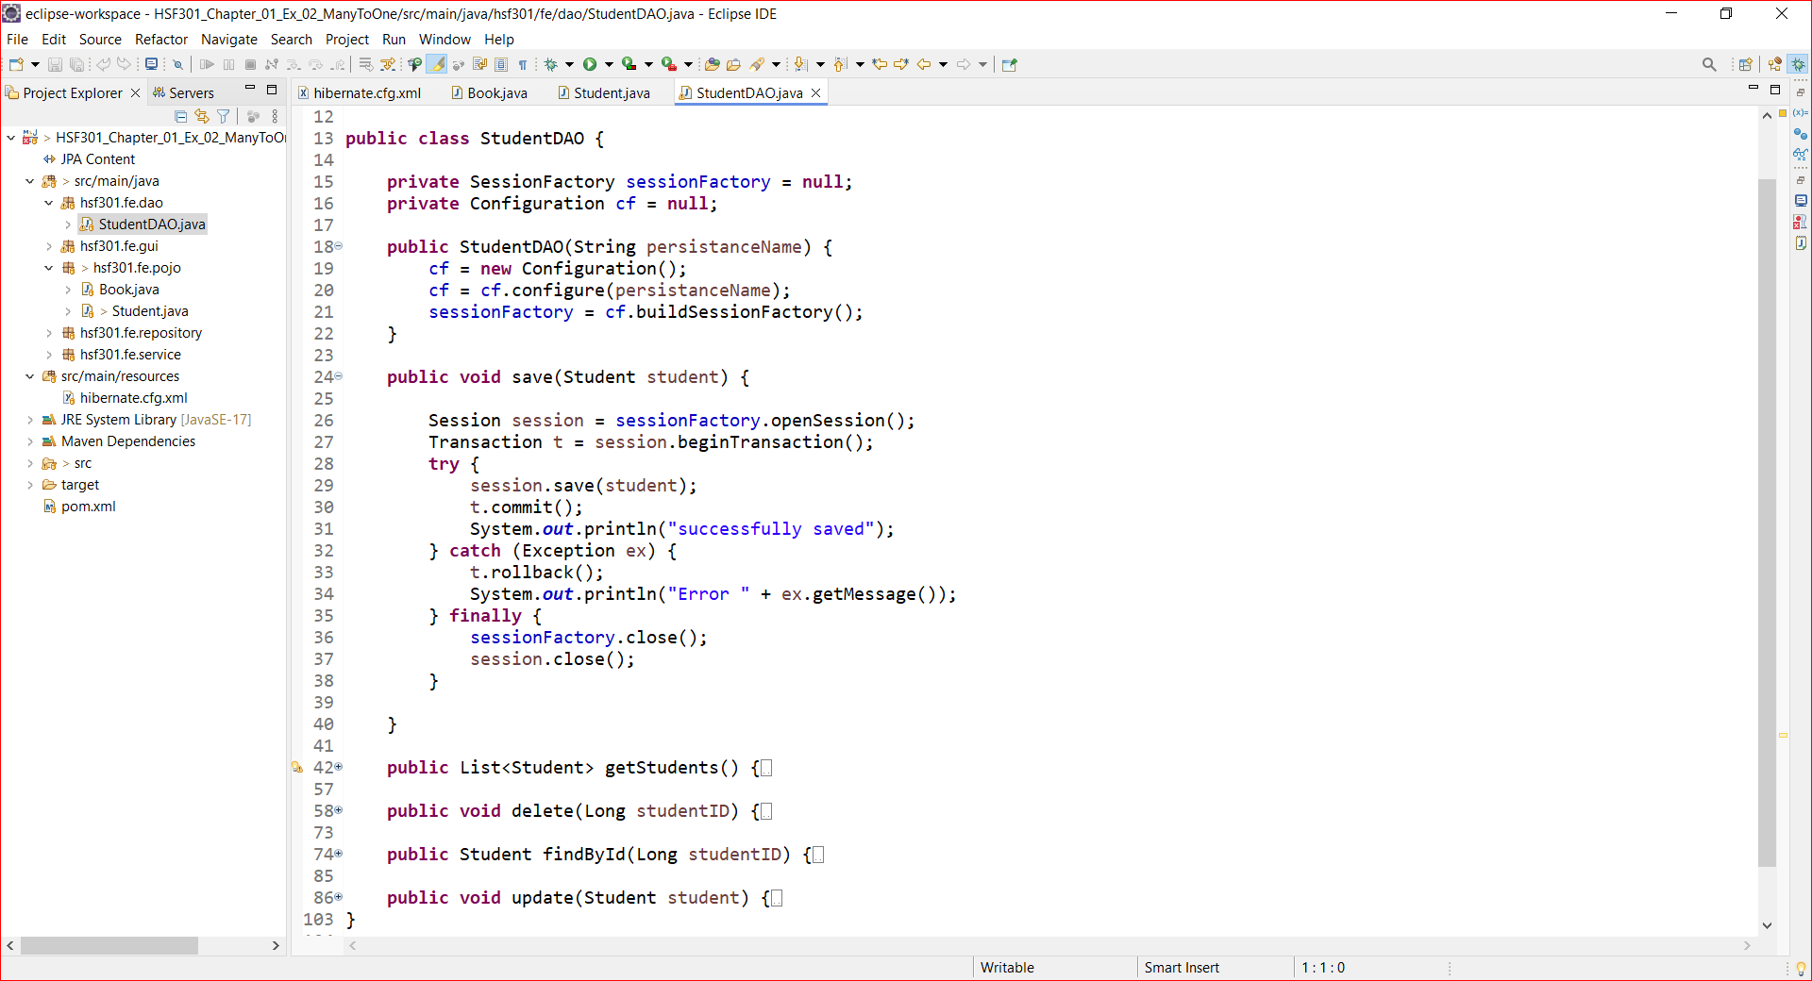
9. Save Student in StudentDAO

Slide 24
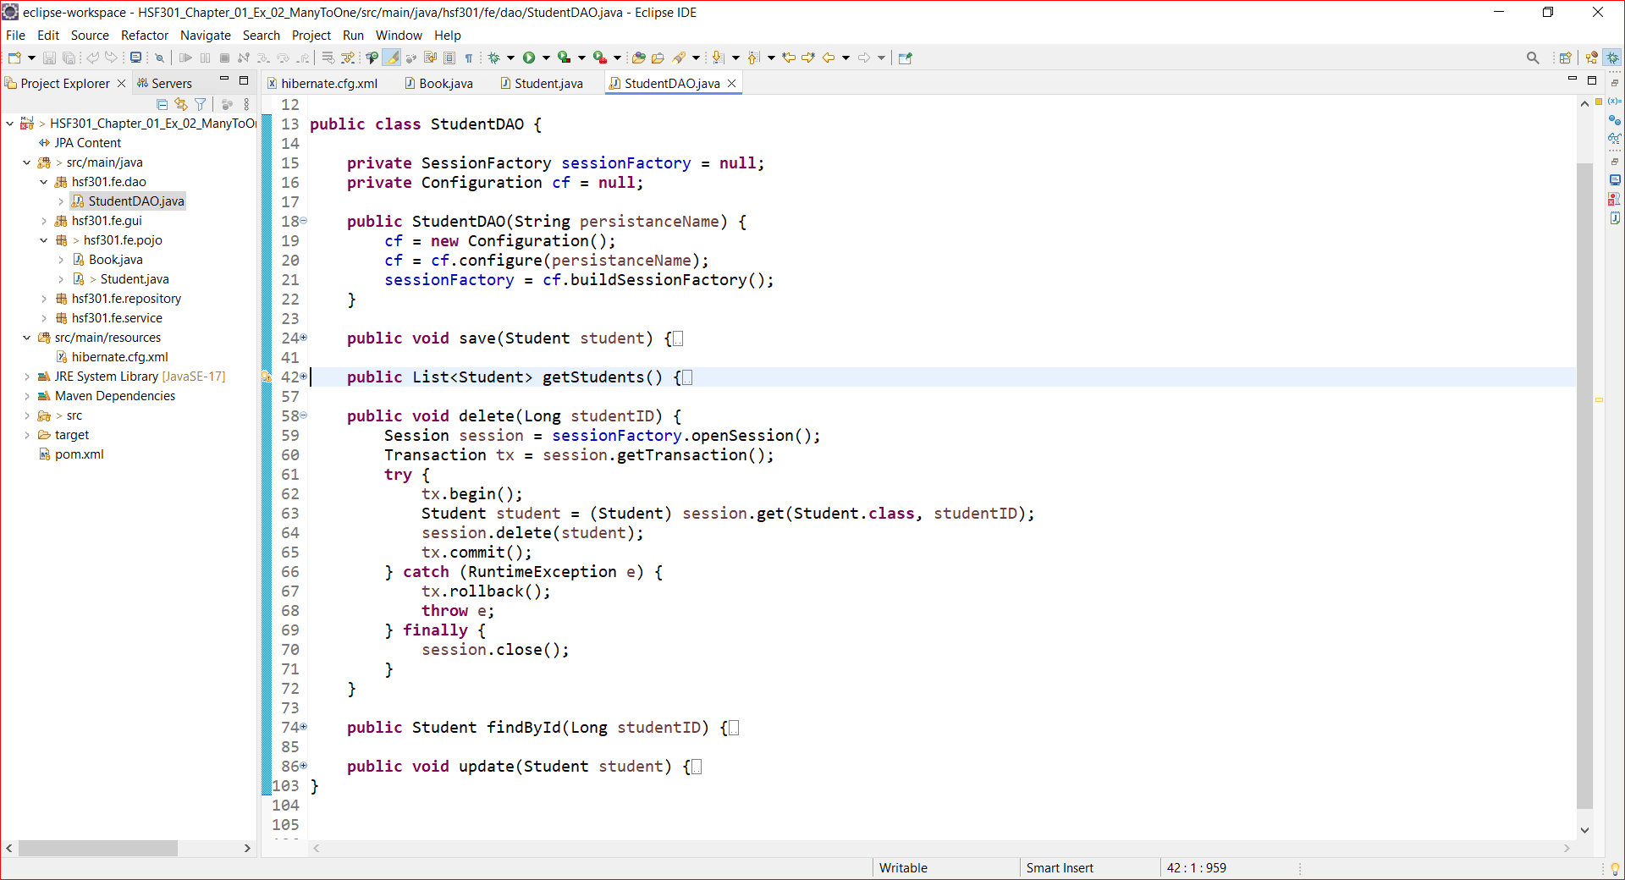
10. Get All Student in StudentDAO

Slide 25

11. Delete Student in StudentDAO

Slide 26
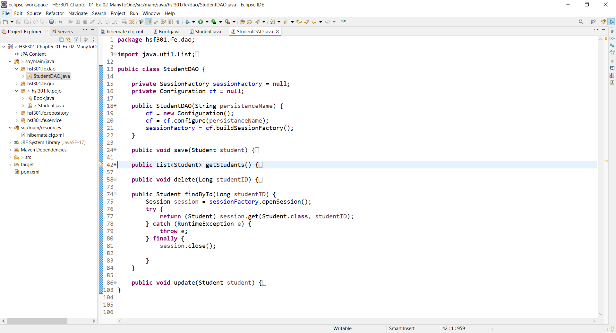
12. Find A Student in StudentDAO

Slide 27
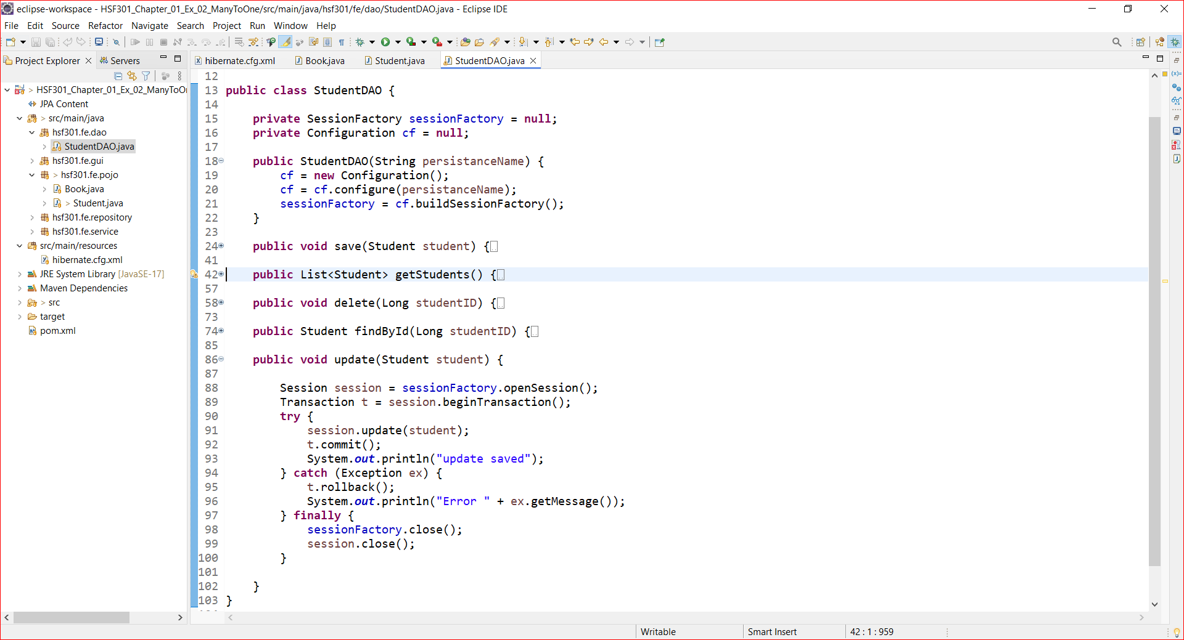
13. Update a Student in StudentDAO

Slide 28
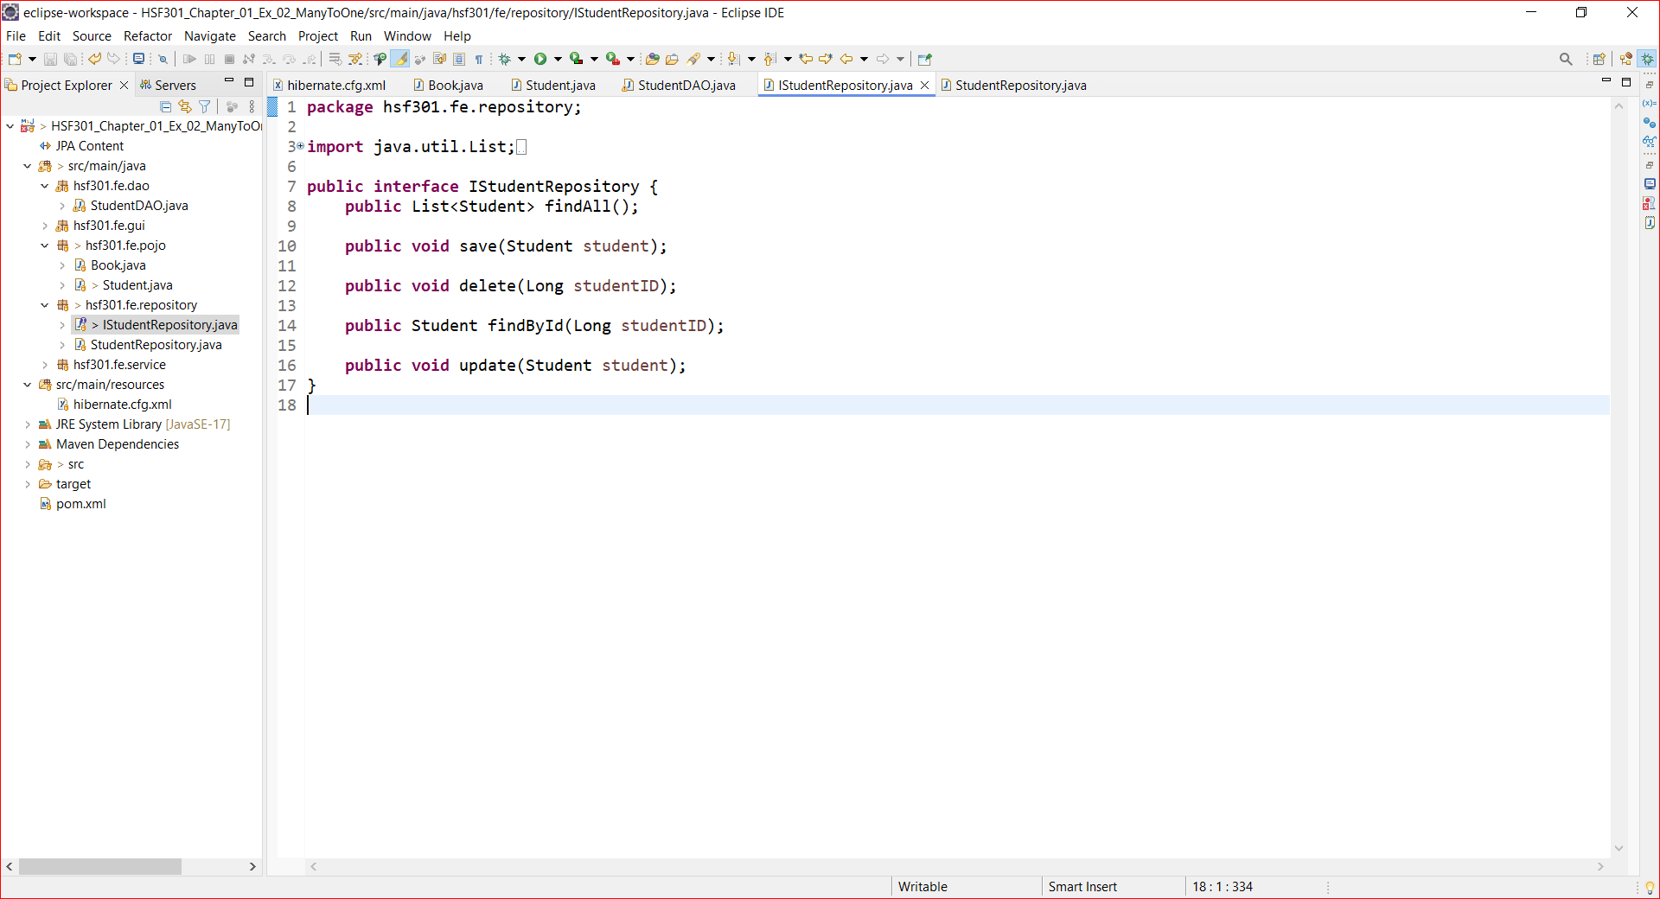
14. Create IStudentRepository

Slide 29
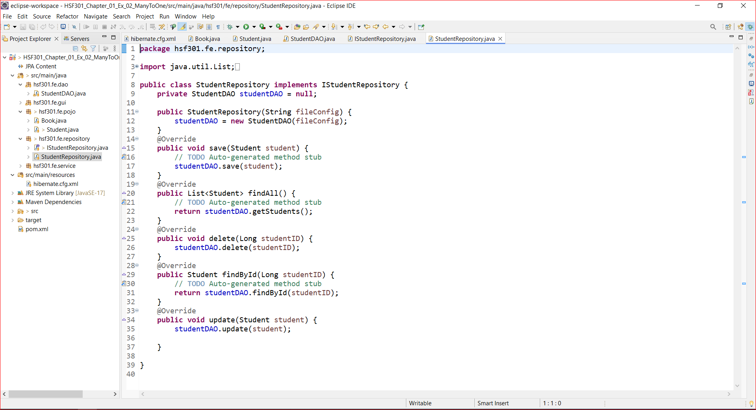
15. Create StudentRepository

Slide 30
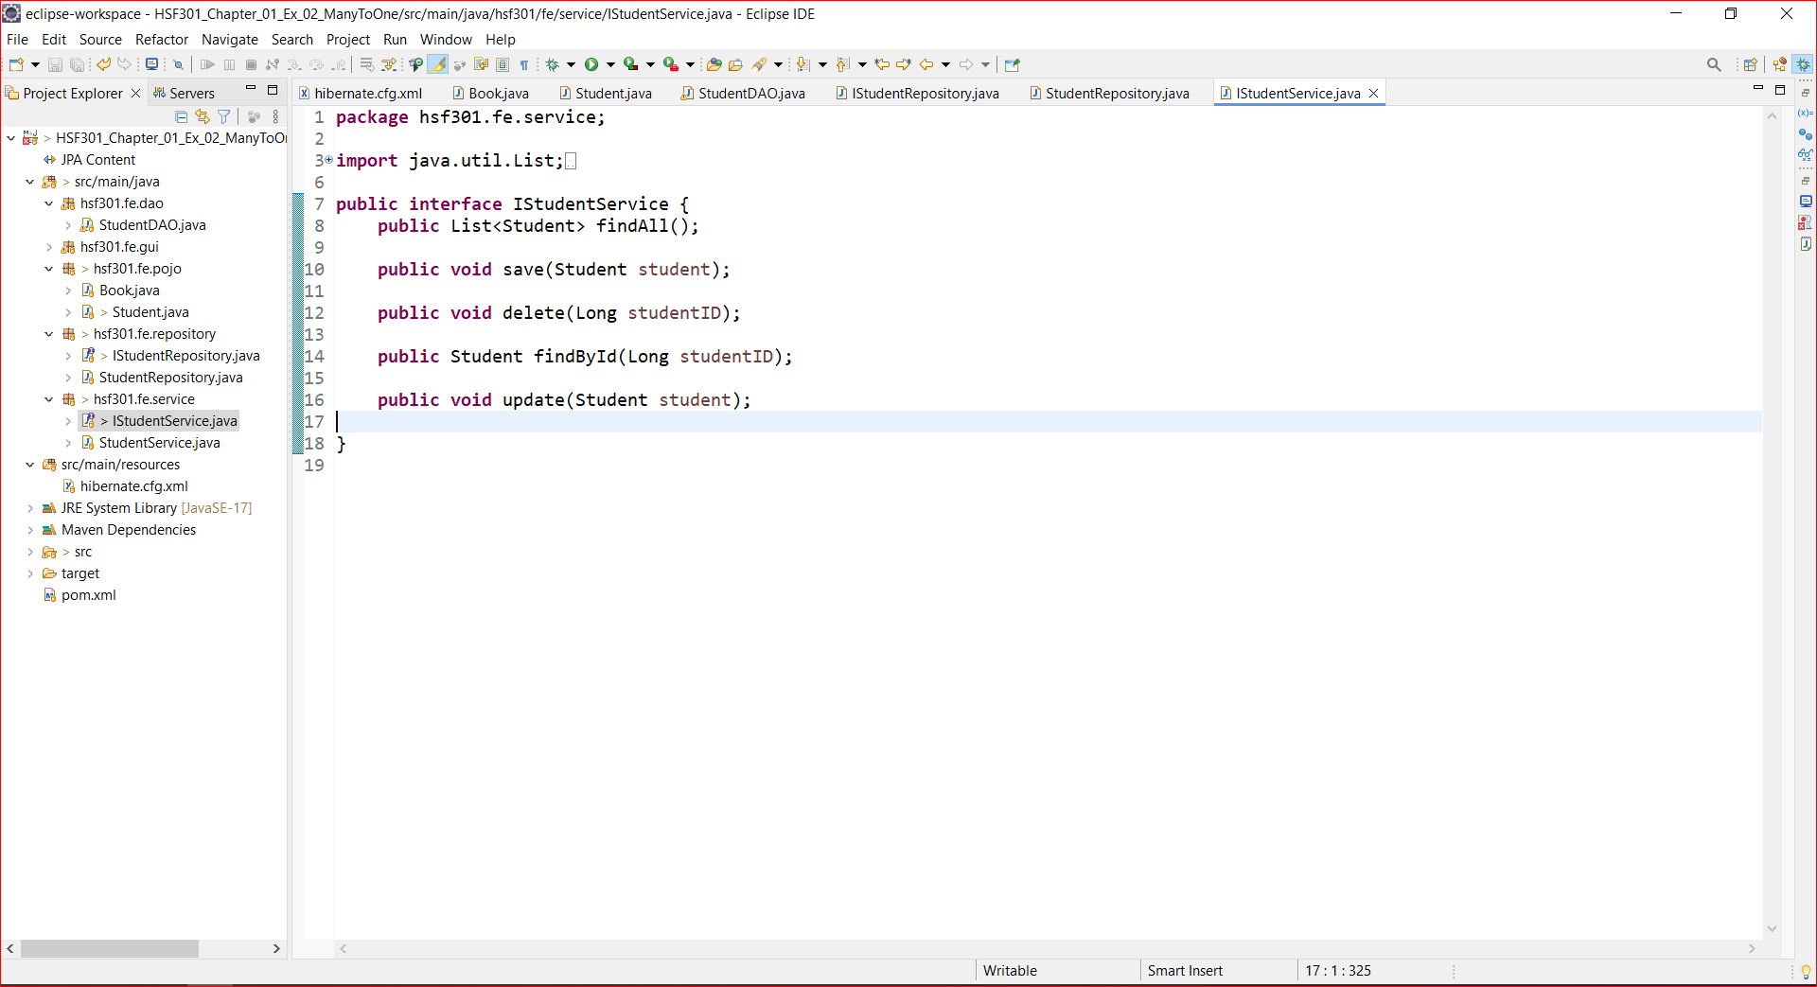
16. Create IStudentService

Slide 31
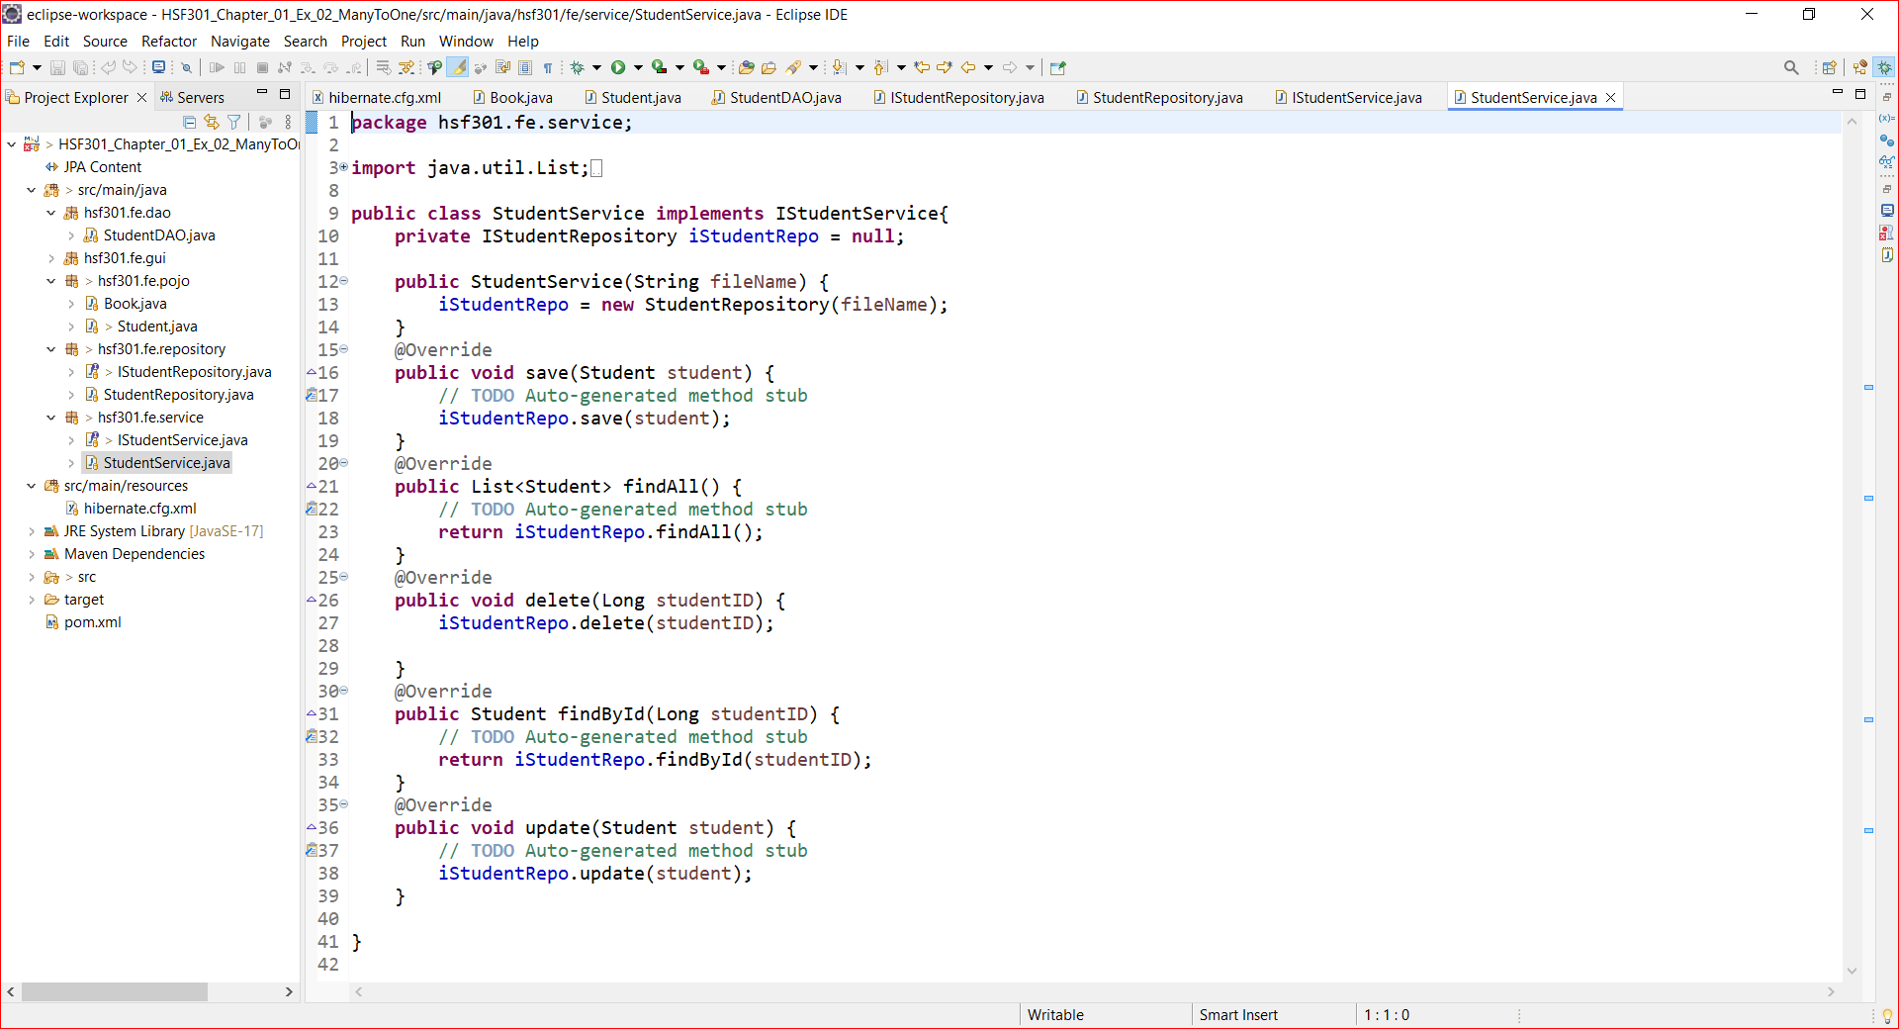
17. Create StudentService

Slide 32
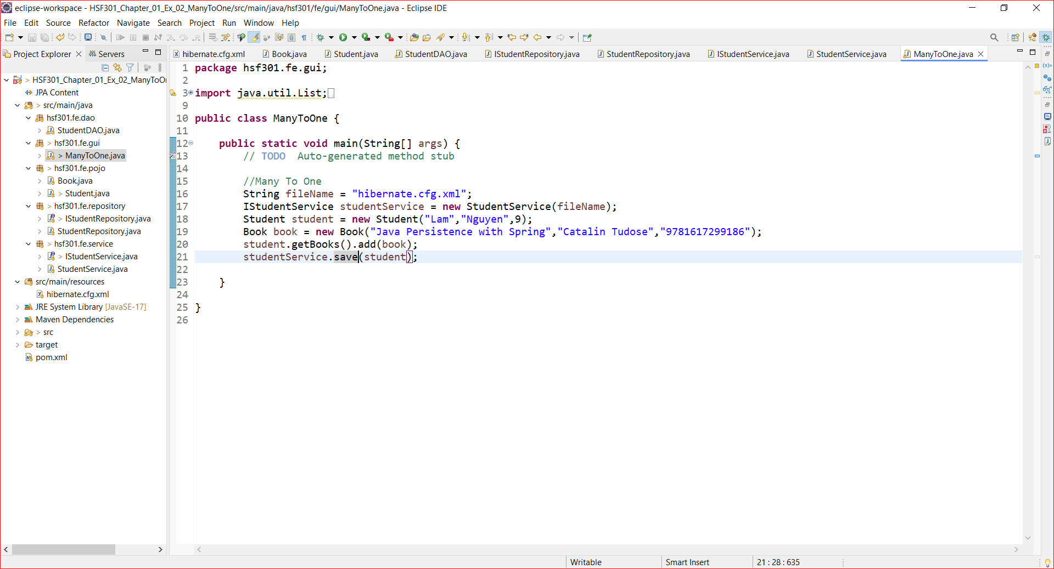
18. Create Main Function

Slide 33
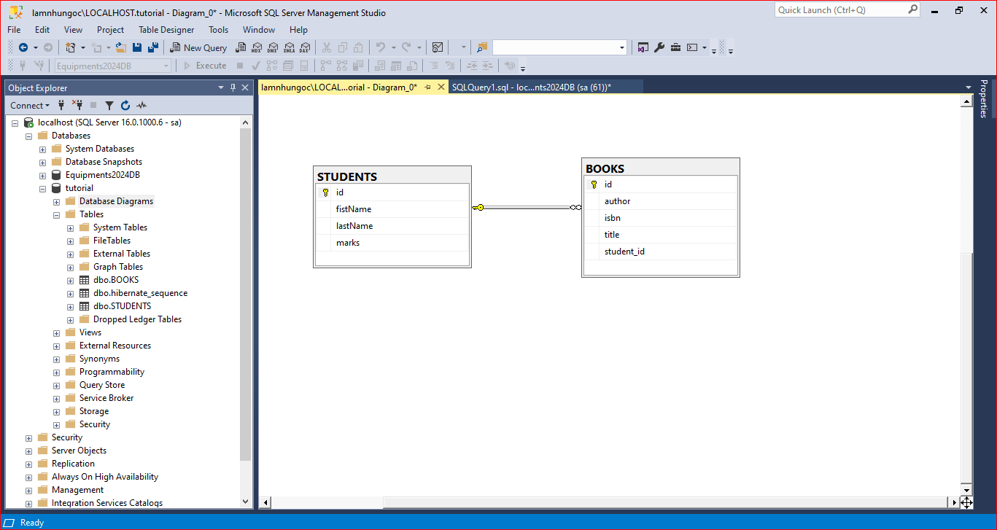
19. Result

Slide 34
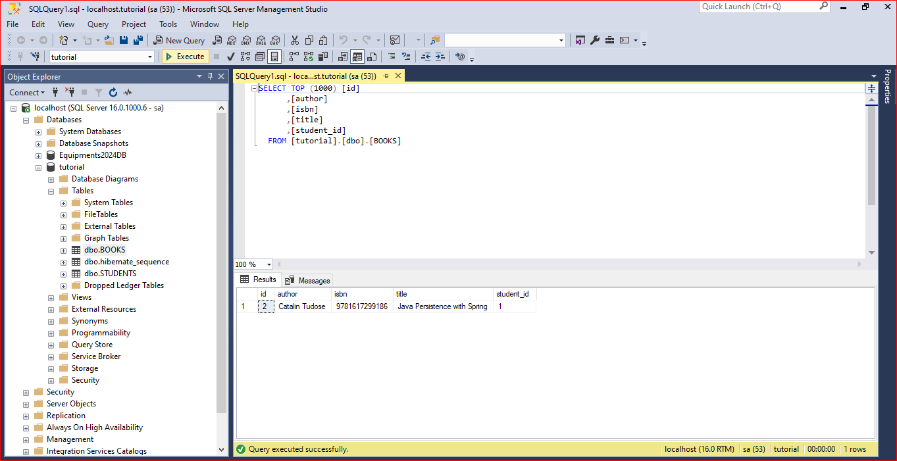
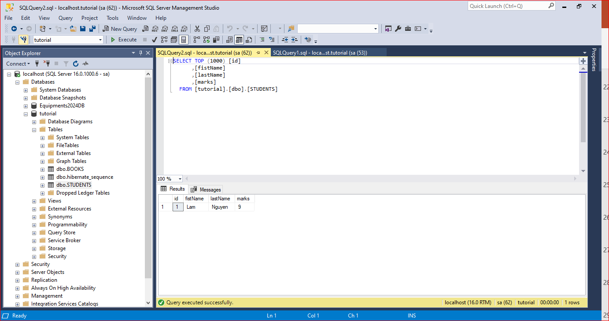
20. Result

Slide 35
Design GUI Application with JavaFX

Slide 36
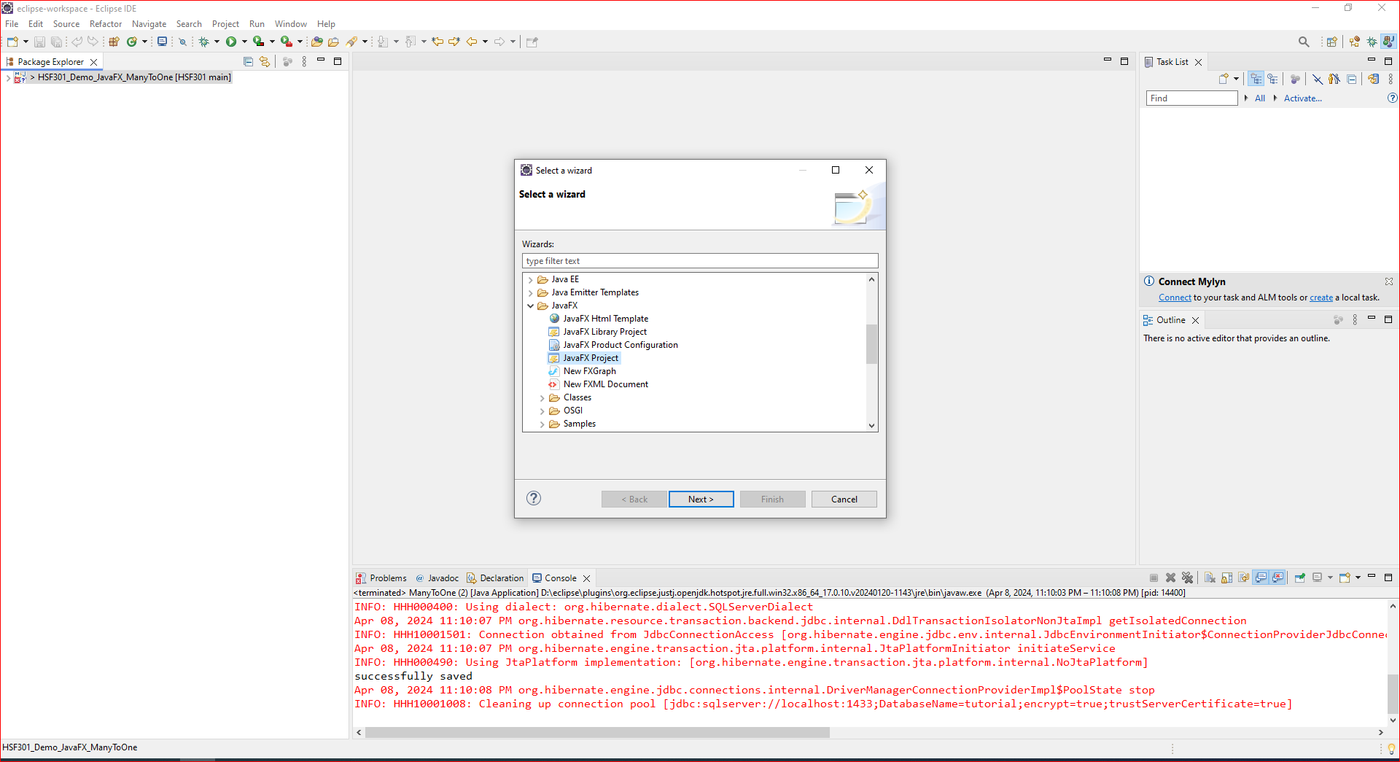
1. Open Eclipse, File | New | JavaFX Project

Slide 37
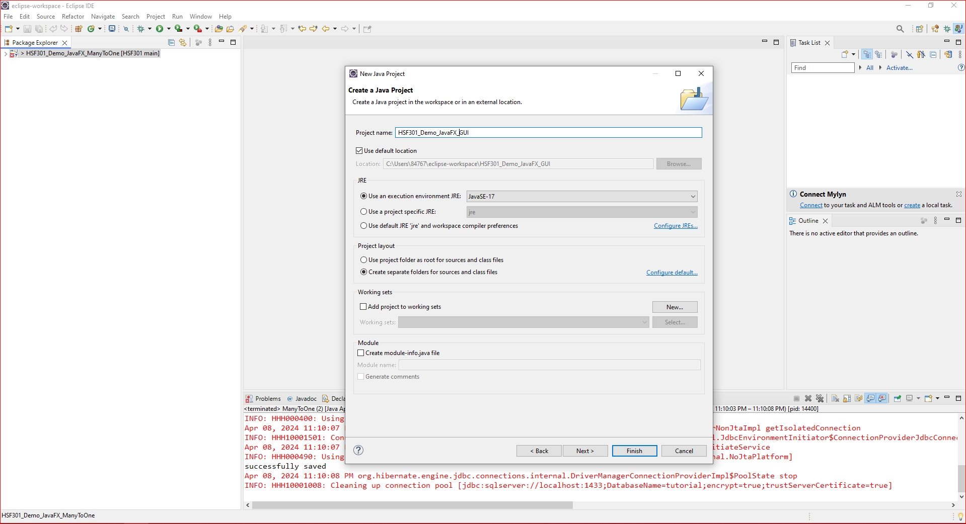
2. Fill the Project Name

Slide 38
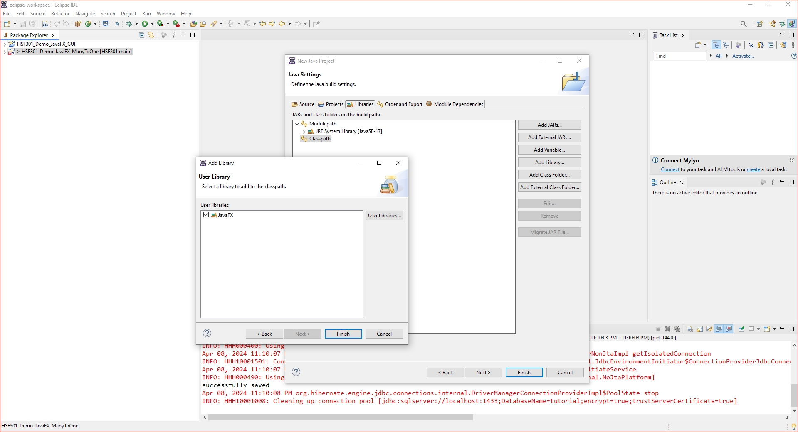
3. Add JavaFX to Project

Slide 39
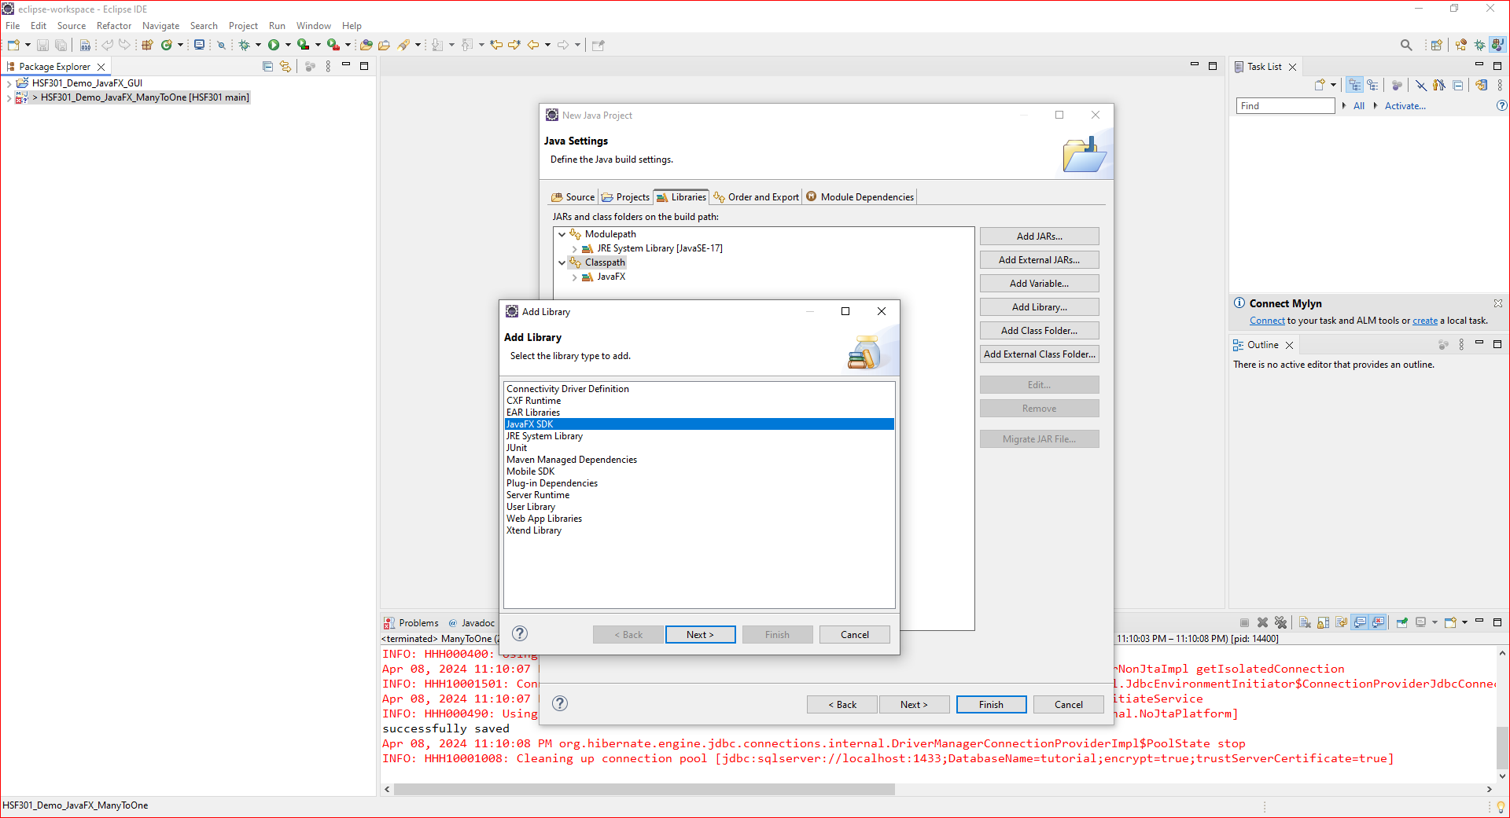
5. Add JavaFX SDK to Project

Slide 40
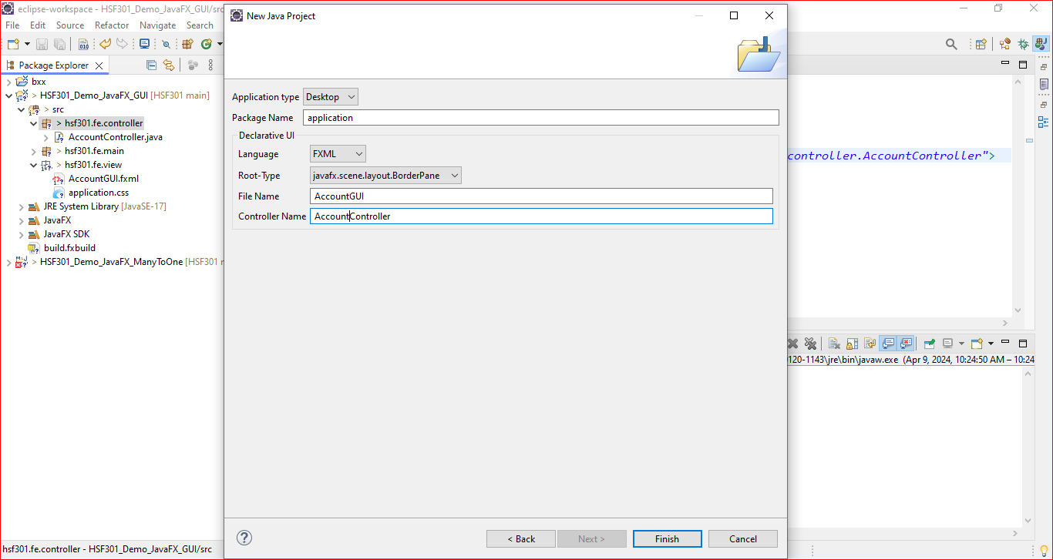
6. Choose the application type

Slide 41
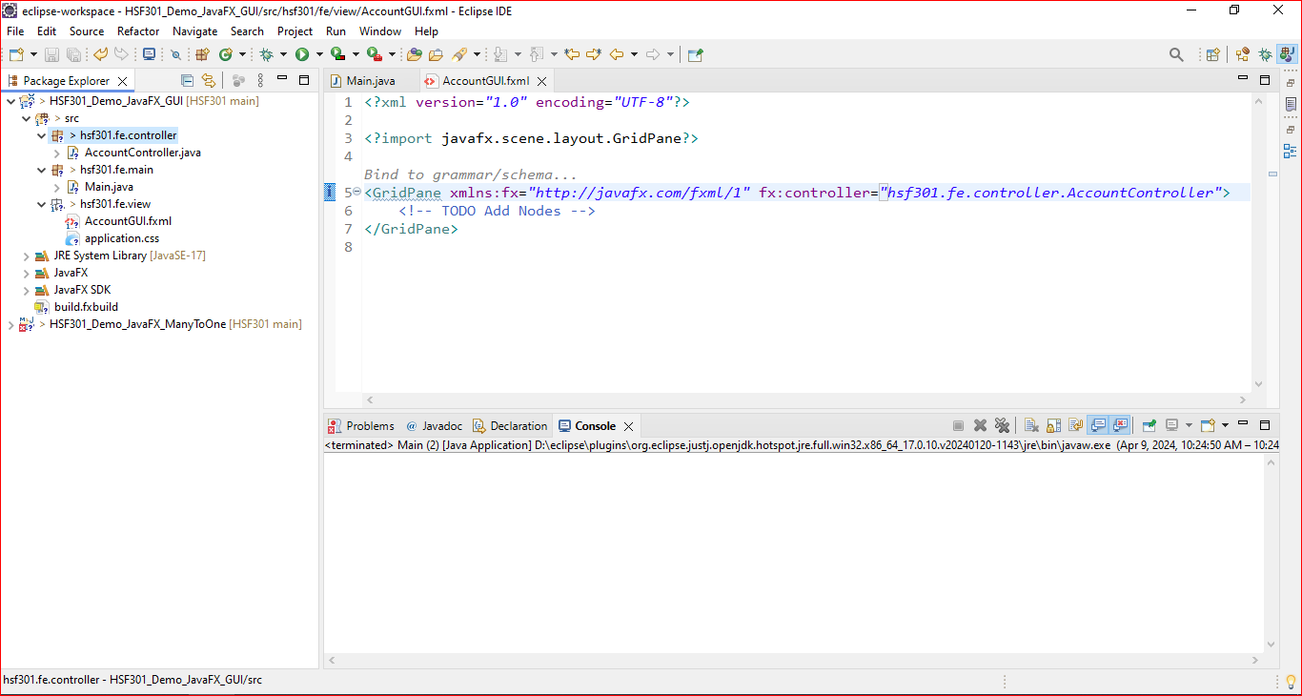
7. Build the Architecture

Slide 42
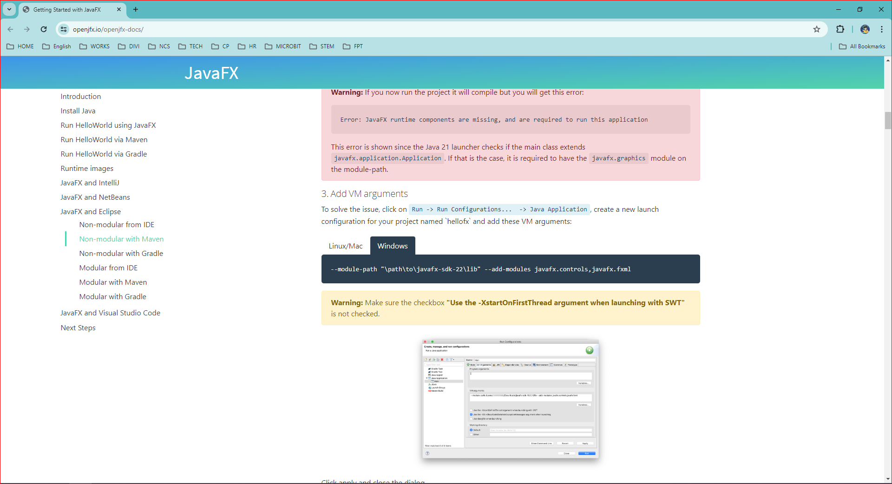
8. Open the page | copy VM arguments

Slide 43
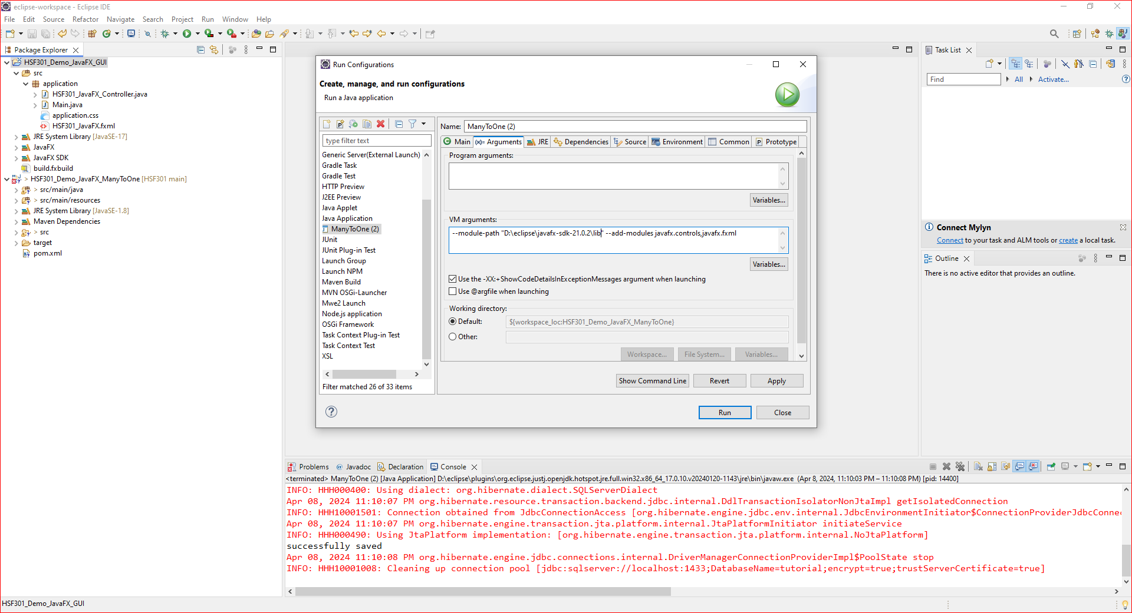
9. Right Click | Run Configurations…

Slide 44
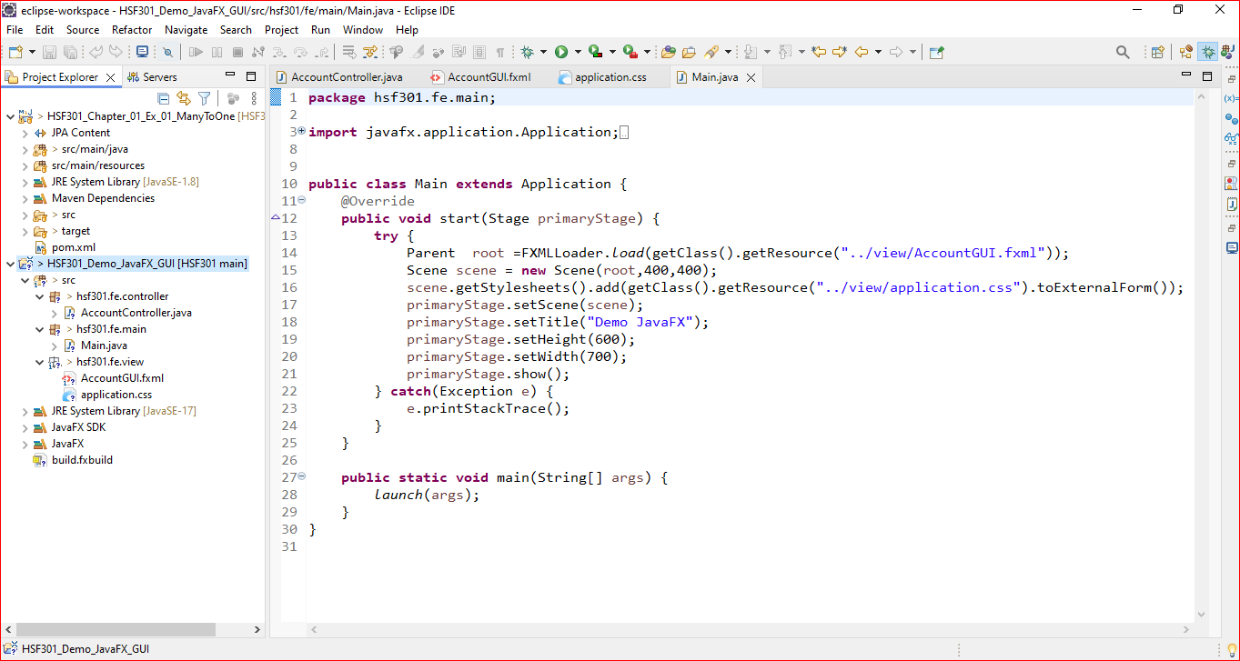
10. Edit Main File

Slide 45
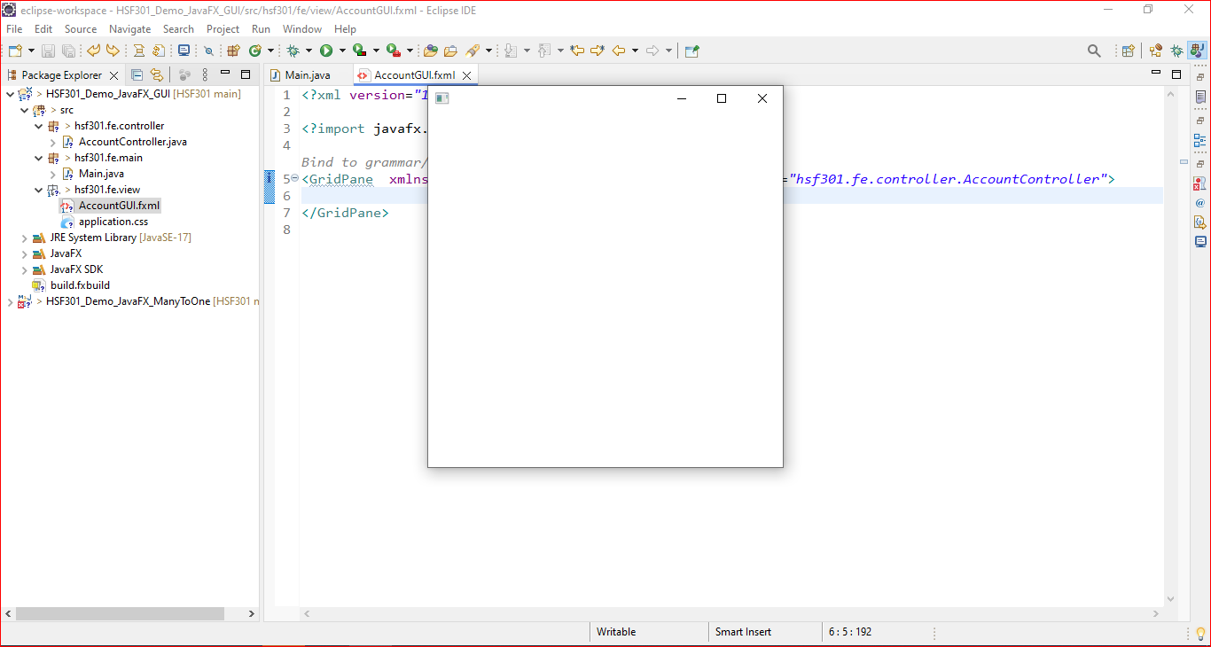
11. Run JavaFX Project

Slide 46
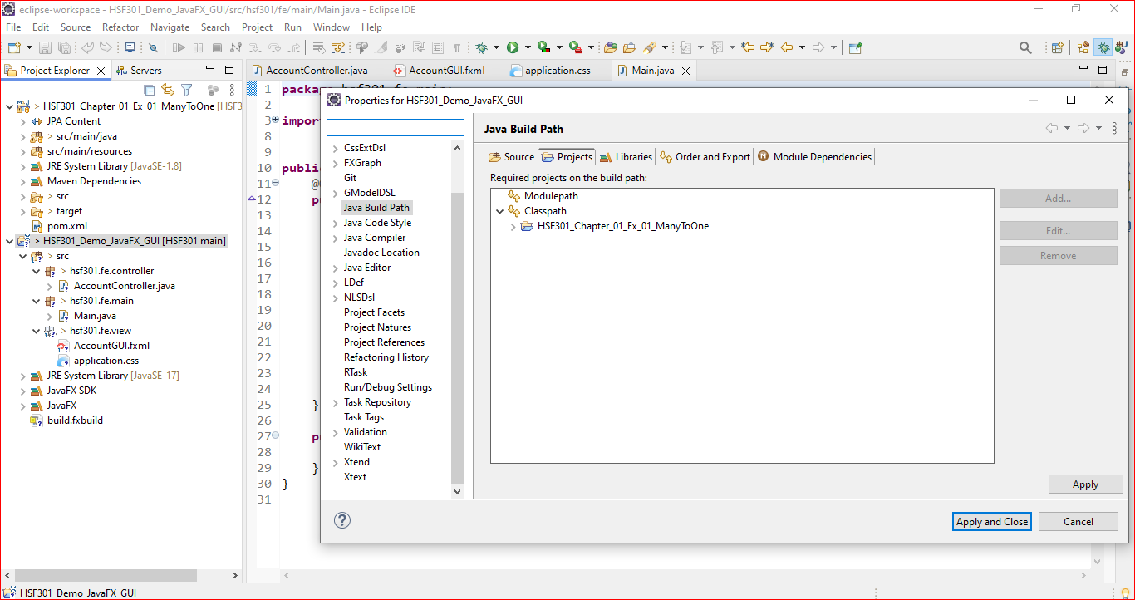
12. Add Reference Another Project

Slide 47
13. Open AccountGUI.fxml in SceneBuilder

Slide 48
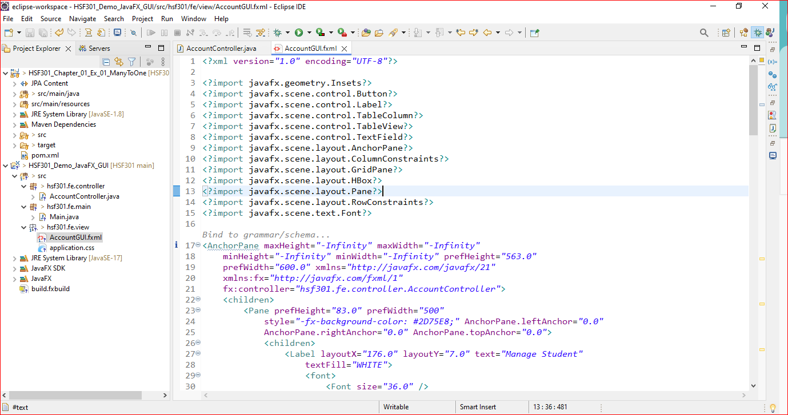
14. Edit Account.fxml

Slide 49
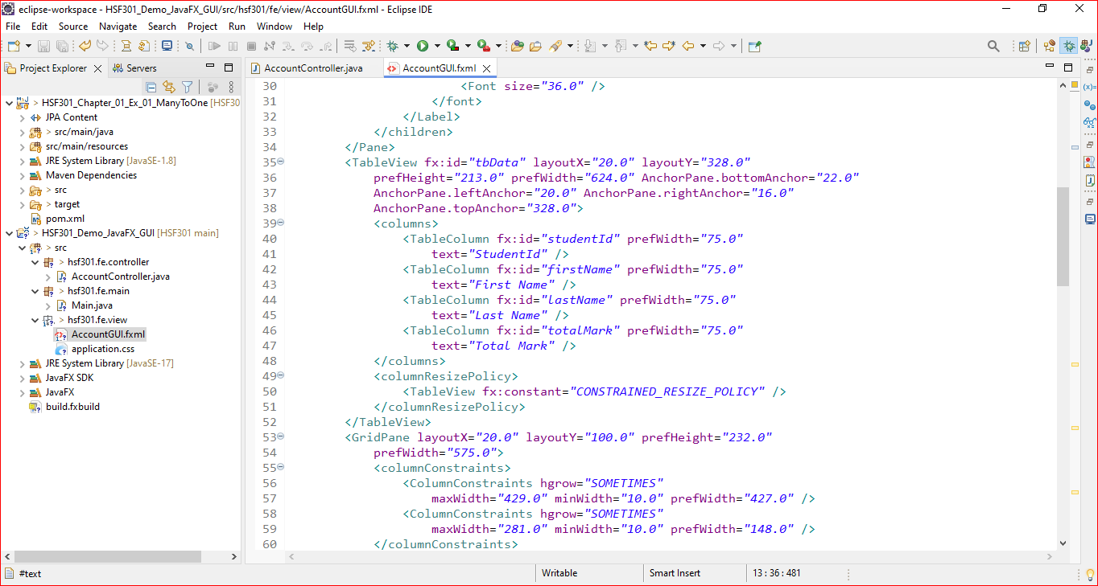
15. Edit Account.fxml

Slide 50
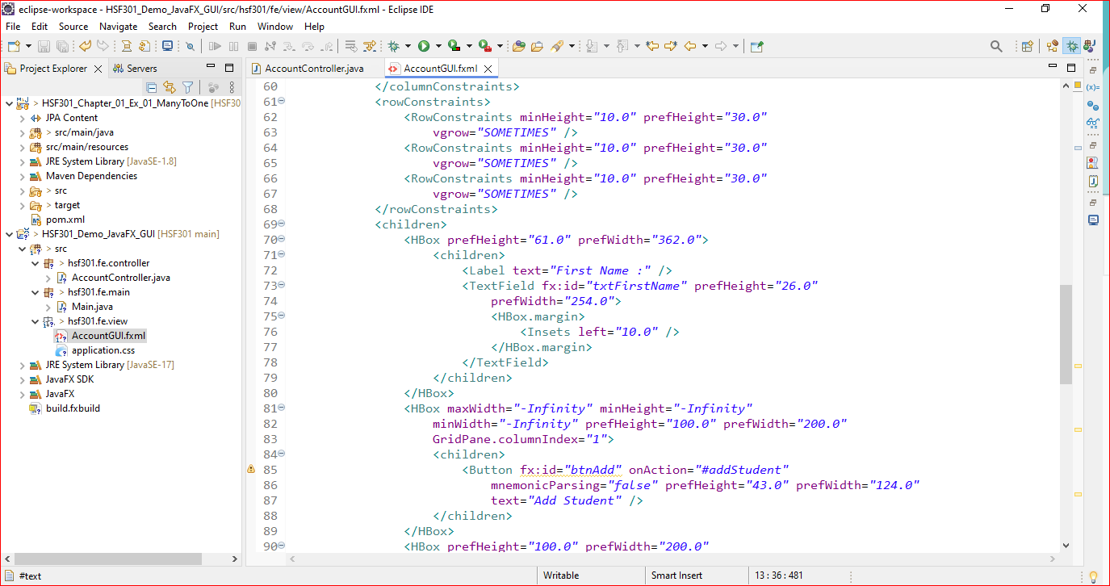
16. Edit Account.fxml

Slide 51
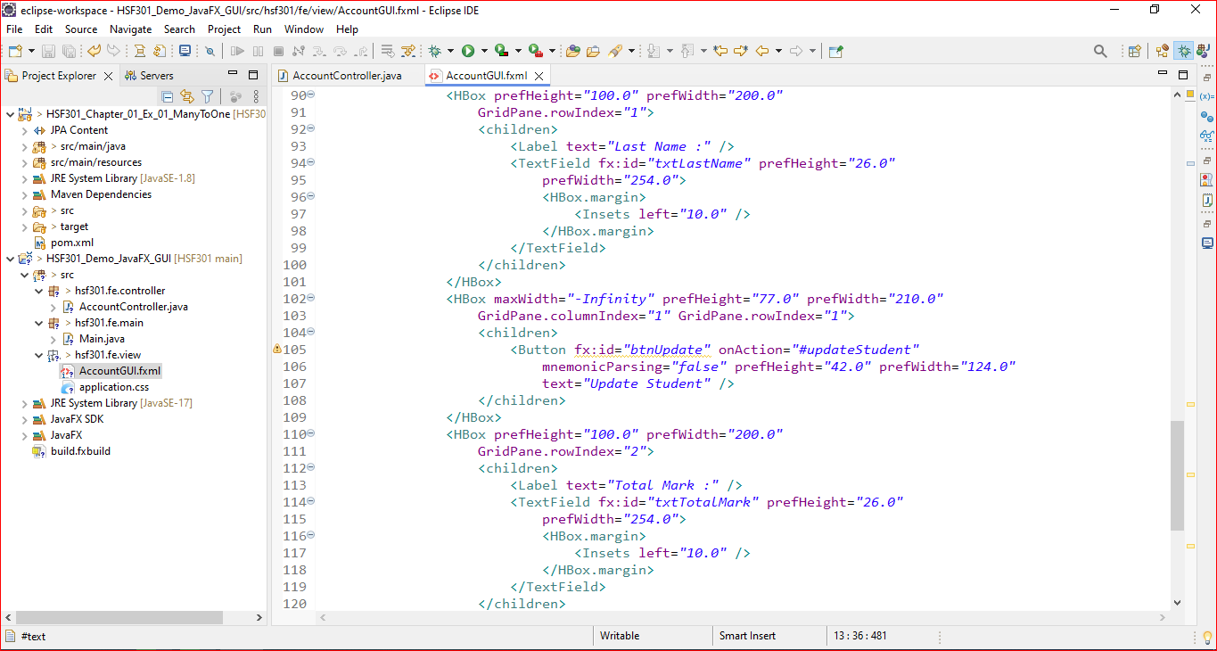
17. Edit Account.fxml

Slide 52
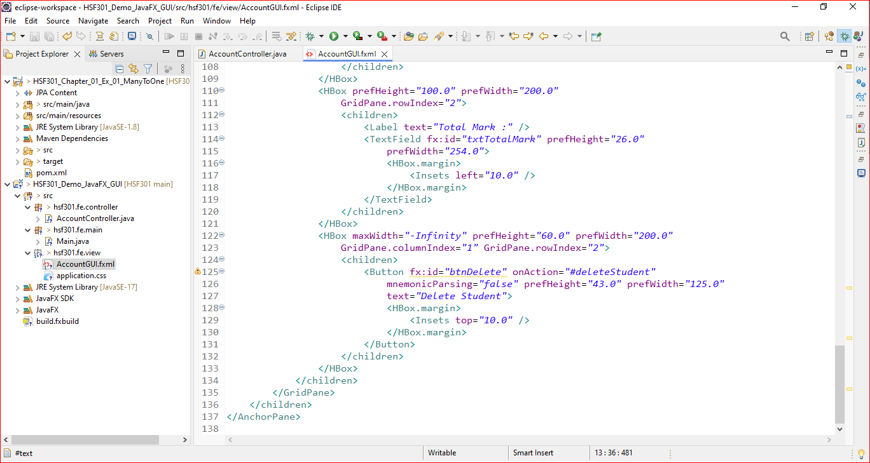
18. Edit Account.fxml

Slide 53
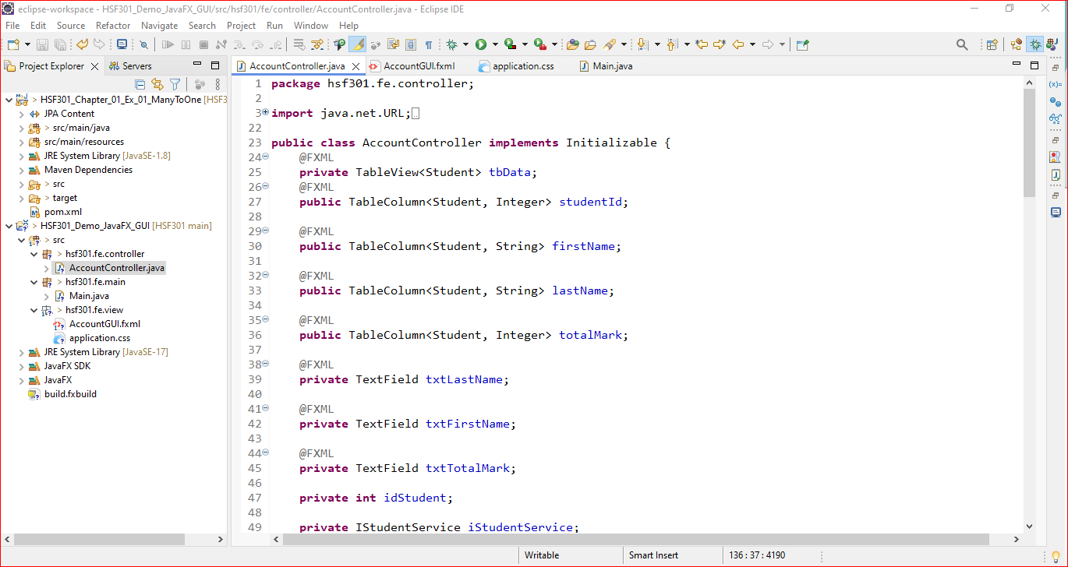
19. Edit the AccountController.java

Slide 54
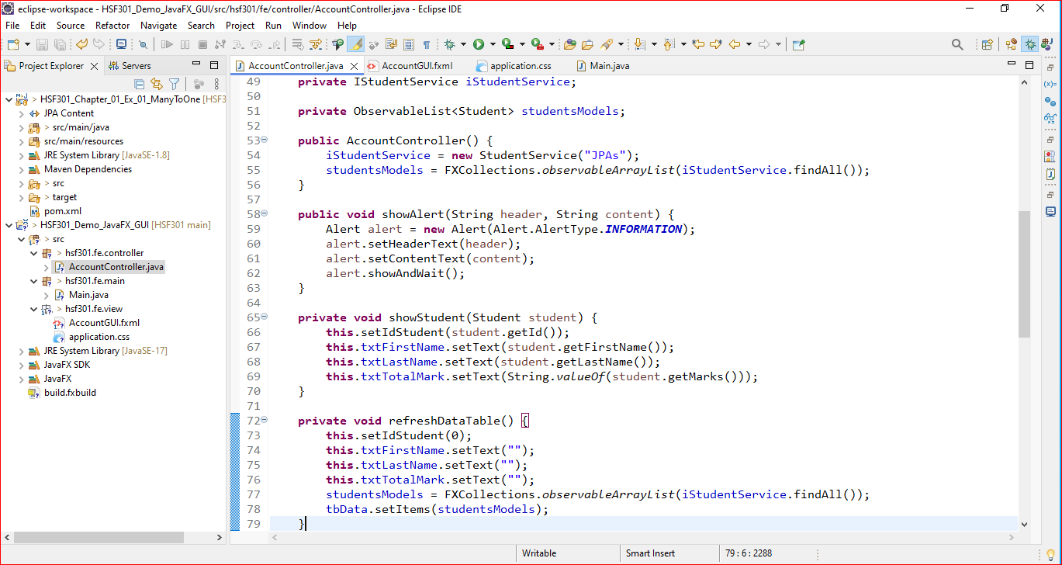
20. Edit the AccountController.java

Slide 55
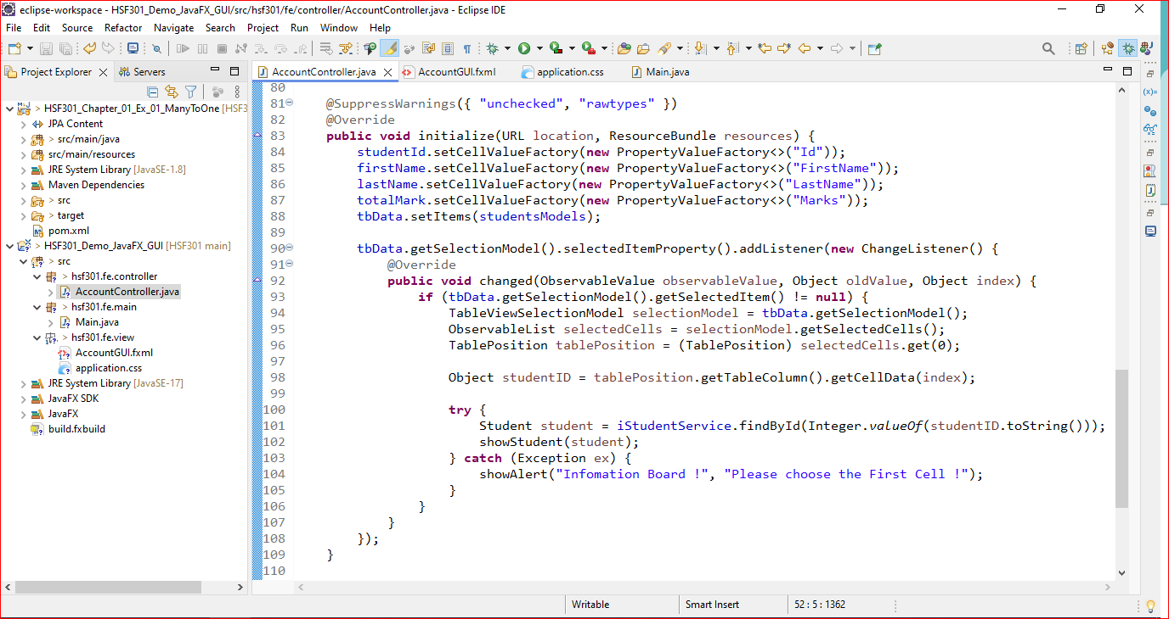
21. Show all student and get StudentID when click first cell

Slide 56
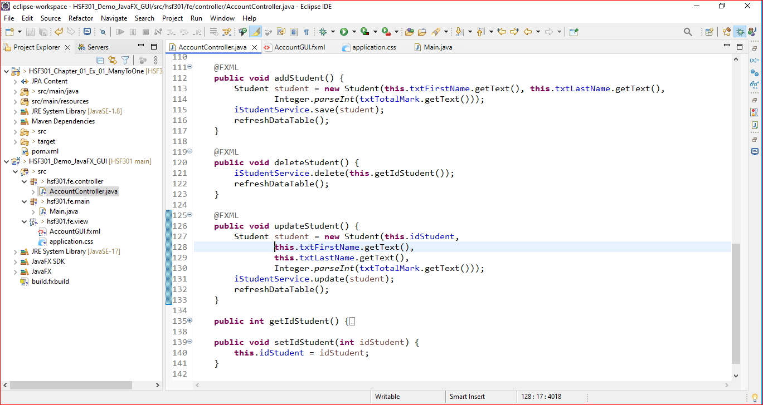
22. CRUD for Students

Slide 57
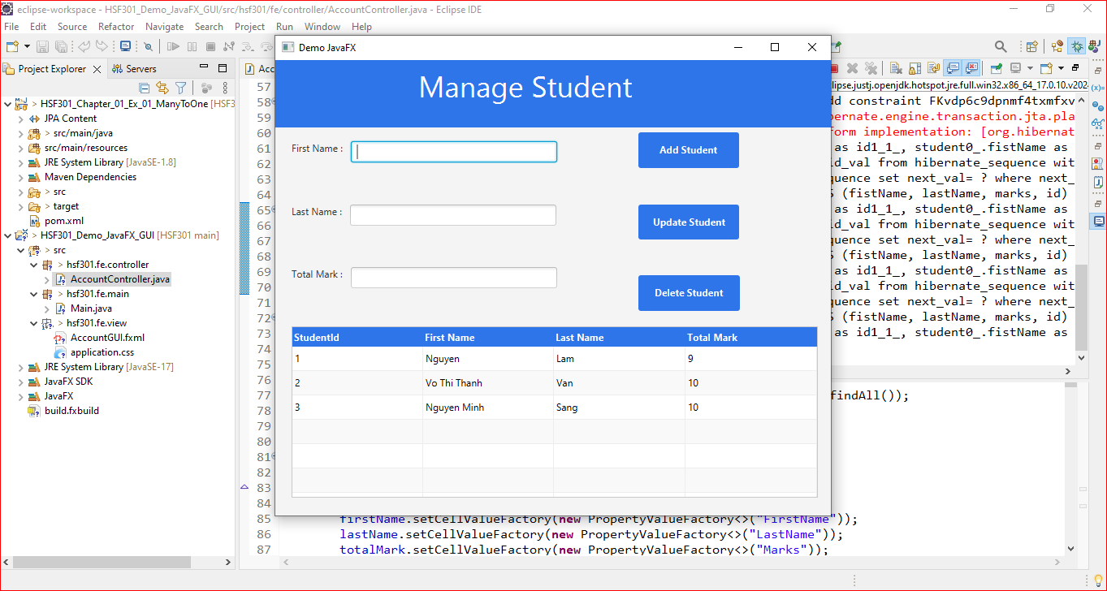
23. Run Project

Slide 58
Summary
Concepts were introduced:
Implement CRUD (Create, Read, Update, Delete) operations to manage data effectively.
Utilize Hibernate to map Java objects to database tables, simplifying data persistence and retrieval.
Design and develop a user-friendly interface using JavaFX, enabling seamless interaction with the application.
Implement features such as form input validation, error handling, and feedback mechanisms to enhance user experience.

